Slide 1
Reunión del grupo KEEP+ de CEIDEN.
Grupo de Formación y gestión del conocimiento.
Fecha: 22-10-2024
Lugar: Escuela Técnica Superior de Ingenieros Industriales de Madrid, ETSIIM-UPM.
Edificio Nuclear de la ETS de Ingenieros Industriales de Madrid,
2ª planta , Biblioteca.

Slide 2

Estimación de:
Nuevas incorporaciones de
Titulados Superiores
Sector Nuclear
5 años
Empresa/Institución | 2023 | 2024 | 2025 | 2026 | 2027 | TOTAL
1 | 80 | 63 | 33 | 20 | 20 | 216
2 | 27 | 45 | 63 | 33 | 36 | 204
3 | 30 | 34 | 39 | 45 | 52 | 200
4 | 20 | 25 | 30 | 25 | 25 | 125
5 | 42 | 29 | 24 | 1 | 1 | 97
6 | 16 | 16 | 16 | 16 | 16 | 80
7 | 10 | 15 | 12 | 9 | 14 | 60
8 | 12 | 10 | 9 | 8 | 8 | 47
9 | 12 | 8 | 8 | 8 | 8 | 44
10 | 3 | 3 | 2 | 1 | 10 | 19
11 | 3 | 2 | 2 | 4 | 6 | 17
12 | 3 | 3 | 3 | 2 | 2 | 13
13 | 4 | 4 | - | - | - | 8
14 | 1 | 2 | 0 | 1 | 1 | 5
15 | 1 | 1 | 1 | 1 | 1 | 5
16 | 2 | 3 | - | - | - | 5
17 | 1 | 1 | 1 | 1 | 1 | 5
18 | 1 | 2 | 0 | 0 | 0 | 3
19 | 1 | 1 | 1 | 1 | 1 | 5
20 | 2 | 4 | 5 | 7 | 8 | 26
21 | 12 | 24 | 30 | 50 | 60 | 176
22 | 23 | 4 | 5 | 6 | 5 | 43
23 | 10 | 7 | 7 | 6 | 0 | 30
TOTAL | 316 | 306 | 291 | 245 | 275 | 1433

Slide 3
Estimación de
Nuevas incorporaciones de
Técnicos de
Formación Profesional sector nuclear –
5 años
Empresa / institución | 2023 | 2024 | 2025 | 2026 | 2027 | TOTAL
1 | 76 | 60 | 31 | 19 | 19 | 205
2 | 16 | 16 | 16 | 16 | 16 | 80
3 | 20 | 20 | 16 | 10 | - | 66
4 | 4 | 8 | 10 | 12 | 16 | 50
5 | 7 | 9 | 10 | 9 | 9 | 44
6 | 10 | 10 | 10 | 5 | 5 | 40
7 | 12 | 6 | 5 | 5 | 0 | 28
8 | 4 | 5 | 5 | 4 | 5 | 23
9 | 2 | 4 | 6 | 3 | 3 | 18
10 | 5 | 3 | 3 | 0 | 0 | 11
11 | 5 | 5 | - | - | - | 10
12 | 5 | 5 | - | - | - | 10
13 | 1 | 1 | 2 | 2 | 3 | 9
14 | 1 | 1 | 1 | 1 | 1 | 5
15 | 2 | 1 | 1 | 1 | 0 | 5
16 | 0 | 1 | 1 | 1 | 1 | 4
17 | 0 | 1 | 0 | 1 | 0 | 2
18 | 0 | 0 | 0 | 0 | 0 | 0
19 | 0 | 0 | 0 | 0 | 0 | 0
20 | 1 | 2 | 2 | 3 | 4 | 12
21 | 0 | 0 | 0 | 0 | 0 | 0
22 | 8 | 14 | 11 | 13 | 14 | 60
23 | 18 | 8 | 7 | 9 | 0 | 42
TOTAL | 197 | 180 | 137 | 114 | 96 | 724

Slide 4
Bienvenidos a esta reunión de CEIDEN keep+ a.
Novedad:
-JEFES DE FORMACION DE CENTRALES NUCLEARES.
-JEFES DE RECURSOS HUMANOS DE CENTRALES NUCLEARES.
-luego, os pediremos, que nos hagáis llegar vuestros comentarios sobre en que se puede mejorar, o que se puede hacer mas. Relativo a las distintas presentaciones que se realizaran.

Slide 5
Javier Dies
-Commissioner Nuclear Safety Council (CSN)
-Chairman Spanish Nuclear Energy Technological Platform R&D CEIDEN
-Professor Chair in Nuclear Engineering*
*currently on special leave
IAEA International Conference on Nuclear Knowledge Management and Human Resources Development ,2024-07-02
Good practices for developing Nuclear Skills , HRD and NKM. In the nuclear sector and in the nuclear regulatory body
Carlos CASTELAO LÓPEZ
AR SAFETY COUNCIL - CSN – CONSEJO DE SEGURIDAD NUCLEAR

Slide 6
This presentation is based on my 38 years of professional experience:
Commissioner at the Spanish Nuclear Safety Council (CSN) 2015-2028
Chairman Spanish Nuclear Energy Technological Platform CEIDEN 2019-
Professor Chair in Nuclear Engineering at UPC-Barcelona Tech Spain, for 30 years.
Vice President of European Nuclear Education Network ENEN, 2013-2016.
Has published more than 240 papers on nuclear Engineering.
Has managed 15 PhD in Nuclear Engineering.
Author of Multimedia on Nuclear Reactor Physics with about 800 pages, translated to 6 languages and distributed through IAEA to more than 129 countries.
Has participated in 13 missions (Argentina, Austria, China, Ghana, Malaysia, Saudi Arabia, South Africa, Tailandia, USA, Vietnam) of the International Atomic Energy Agency (IAEA).
Commissioner that participate in the WENRA meetings since 2015,
Commissioner that participate in the Comity of safety standards CSS of IAEA since 2015.

Slide 7
Overview on Nuclear Skills
Universidades
Con master nuclear
Nuclear organización
Sector nuclear
Training Programs
Recruitment
KM Plans & Retirement
Atraer estudiantes a los programas nucleares y al sector nuclear.
Promotion schemes
Programas universitarios de formation nuclear Nuclear : master nuclear
Bolsa de empleo SNE
From a nuclear safety point of view, nuclear Skills is of paramount importance

Slide 8
Overview on Nuclear Skills in the nuclear regulatory body
8
University
With nuclear masters
Nuclear organization
Regulatory boody
Training Programs
Recruitment
KM Plans & Retirement
Attract students to nuclear programs and nuclear sector
Promotion schemes
Nuclear education
Develop efforts to achieve 50 % of technical staff
From a nuclear safety point of view, nuclear Skills is of paramount importance

Slide 9
Good practices for Recruitment in the nuclear sector
  Bolsa de empleo de la SNE :
La Sociedad nuclear Española SNE ha puesto en marcha la bolsa de empleo..
Todos los estudiantes de los masters en ingeniería nuclear, son animados por sus profesores a registrarse en la bolsa de empleo de la SNE.
Todas las empresas del sector nuclear son animadas a mandar todas sus ofertas de nuevos puestos de trabajo a la bolsa de empleo de la SNE.
  Cuando un Nuevo puesto de trabajo relativo al sector nuclear aparece en España, para titulados superior. Todos los estudiantes registrados en la bolsa de empleo de la SNE, reciben en su correo electrónico, un correo con la descripción de ese puesto de trabajo, y los detalles de contacto con esa empresa.
La bolsa de empleo también permite ofertar practicas en empresas en el sector nuclear.

Slide 10
Key Points: University - National level
Enhance support to Universities with well established master’s degrees:
National level
CSN Nuclear Safety council & Nuclear Chairs, 4 chairs in nuclear safety and radiation protection sponsored with 70.000 €/year since 2010.
Collaboration with utilities in education programs in nuclear engineering
Country Nuclear Associations ( SNE, etc.)

Slide 11
Key Points: Nuclear Organizations
Recruitment
Number of new staff in the regulatory body / nuclear sector should be more or less constant → better 10 newcomers/year during six years than 60 newcomers one year and no newcomers during the next 5 years .
It is not easy, when recruiting 60 people:
  -attraction of talented newcomers in one year
  - knowledge transfer to new staff from existing staff

Slide 12
Attract talented people to the regulatory body, to the nuclear sector and to the nuclear education programs
Develop schemes that attract students to nuclear engineering, or radiation protection programs, and to the nuclear sector.
Develop conferences about nuclear, in the universities with masters on nuclear engineering.. - Very good job developed by nuclear youth in Spain.
Award top-ranked student of each promotion
Scholarships for fees in master’s degrees in nuclear engineering and scholarships for accommodation.
Set up a national system to connect nuclear engineers with new positions in nuclear sector.
Strive for a good alignment between demand and supply of nuclear professionals. Foster connection between Academia and Industry.
Foster TV programs / media to explain for the general public: how a NPP operates, description of NPP safety systems, nuclear medical applications (radiotherapy, radiodiagnostic, protontherapy, radon, environmental programs around NPP. how work a nuclear fuel factory, management of irradiated fuel, management of radioactive waste, food conservation, research programs in nuclear field (accident tolerant fuel, long term operation, etc.). SMR, advance nuclear reactors.
In secondary schools curriculums, previous topics should be explained.

Slide 13
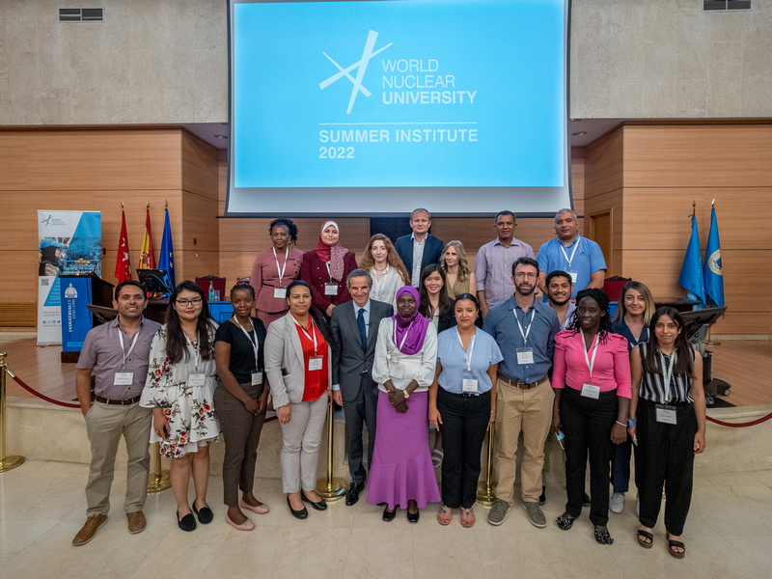
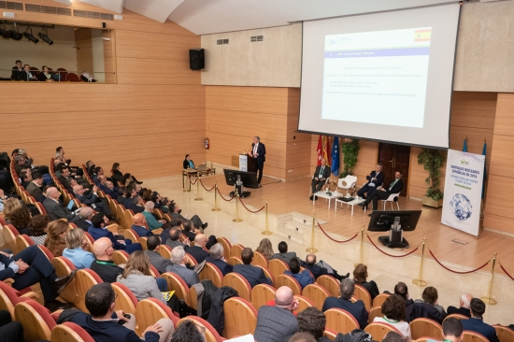
Attract talented people to the regulatory body, to the nuclear sector and to the nuclear education programs
UPM-ETSIIM- Madrid
Workshop on Operation Experience of nuclear power plants SNE. 5 Managers of spanish nuclear power plants . Estudents of nuclear masters also participate .
……
UPM-ETSIIM, Madrid
UPV-ETSIIV Valencia
World Nuclear University,
Summer Institute 2022

Slide 14




The director of the Barcelona School of Industrial Engineering (ETSEIB), Universitat Politècnica de Catalunya – BarcelonaTech
requests the honour of your presence at the inauguration ceremony of the 2019-2020 academic year for the
Master’s degree in Nuclear Engineering (MNE)
European Master’s degree in Nuclear Energy (EMINE)
at the Aula Capella, Barcelona School of Industrial Engineering, Av. Diagonal, 647 Campus Diagonal Sud, Barcelona
On Thursday , 3 of October 2019 at 19.00h
Inaugural presentation by United States NRC Chairman, Ms. Kristine Svinicki
Inaugural presentation by CSN Chairman, Mr. Josep Maria Serena
Presentation by CSN Commissioner, Mr. Javier Dies
Presentation by Director General Nuclear Generation of ENDESA, Mr. Gonzalo Carbó
CSN Award ‘Cátedra Argos’ for outstanding perfomance master MNE-EMINE student
Director Master MNE-EMINE, Mr. Lluís Batet
Director of the ETSEIB-UPC, Ms. Neus Cònsul
Vicerector of UPC, Mr. Jordi Berenguer

Slide 15
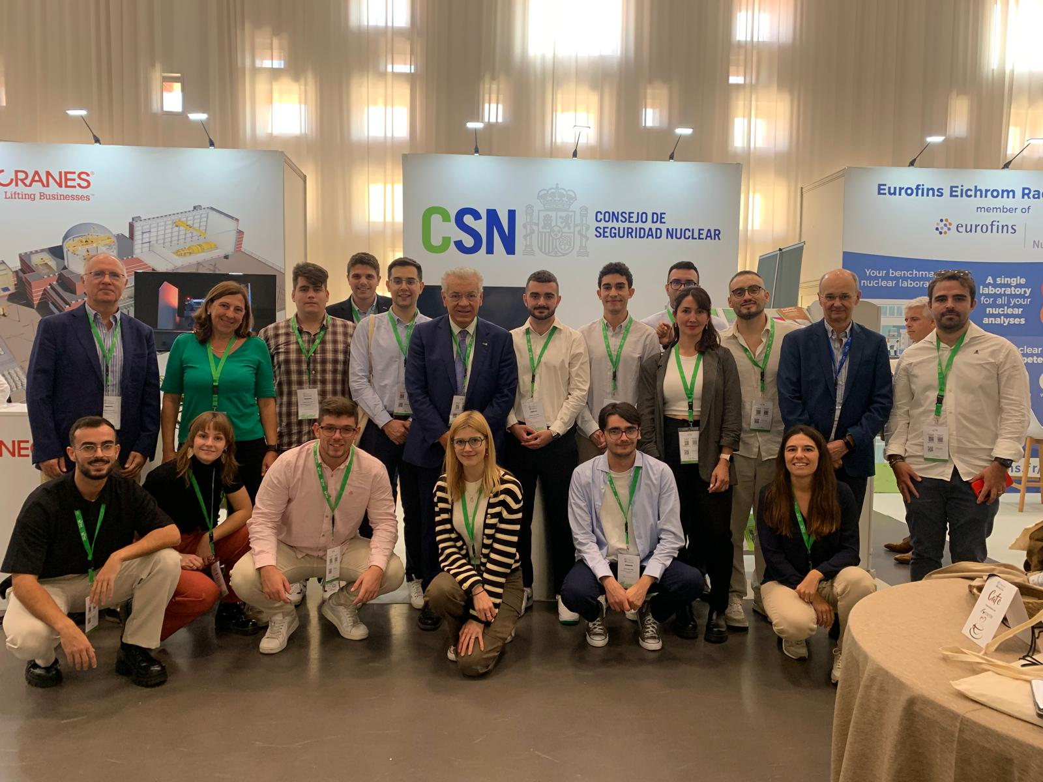
Attract talented people to the regulatory body, to the nuclear sector and to the nuclear education programs
Para el próxima conferencia que tenga dar añadiré esta lamina.
Estudiantes del master de seguridad nuclear y protección radiológica de la UP –Valencia asisten a la reunión anual de la sociedad nuclear Española en Córdoba.

