Slide 1
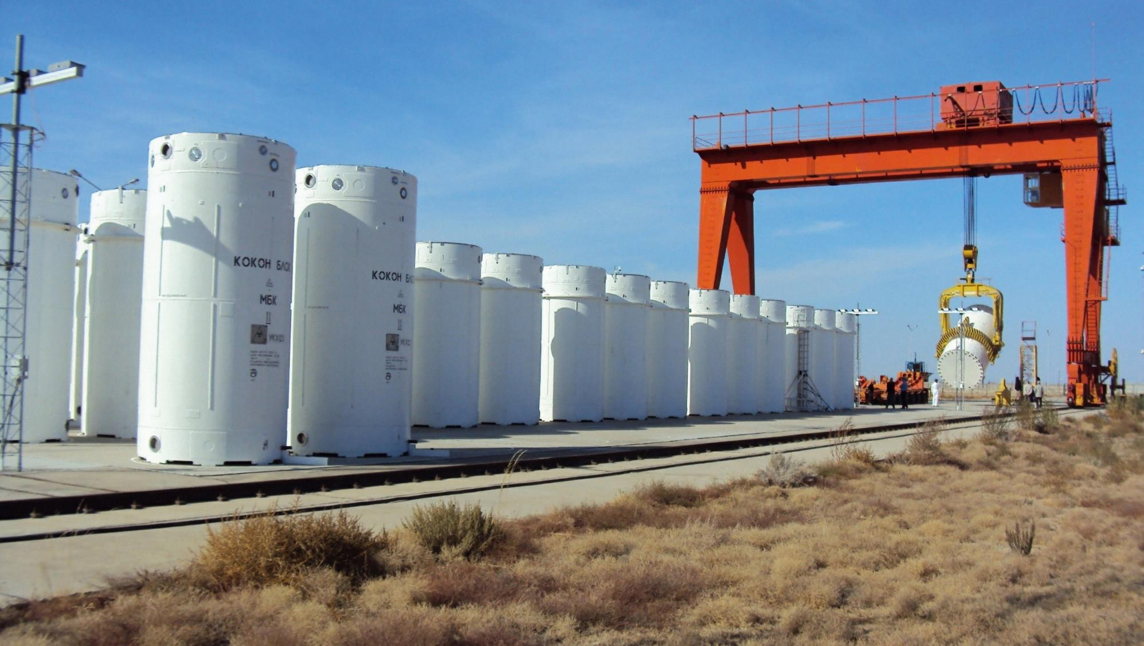
The Next Nuclear Energy Era: New Opportunities and Old Challenges
Universidad Politécnica de Madrid (UPM) ETSIME
17 January 2024
William D. Magwood, IV
Director-General
OECD Nuclear Energy Agency

Slide 2
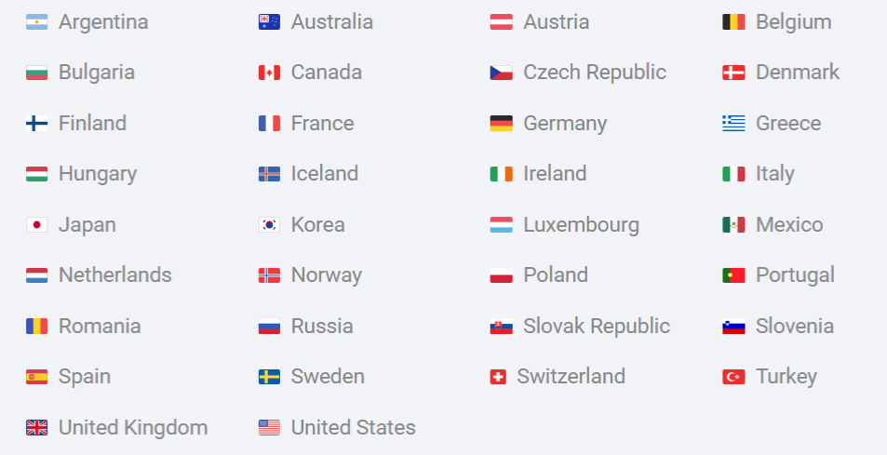
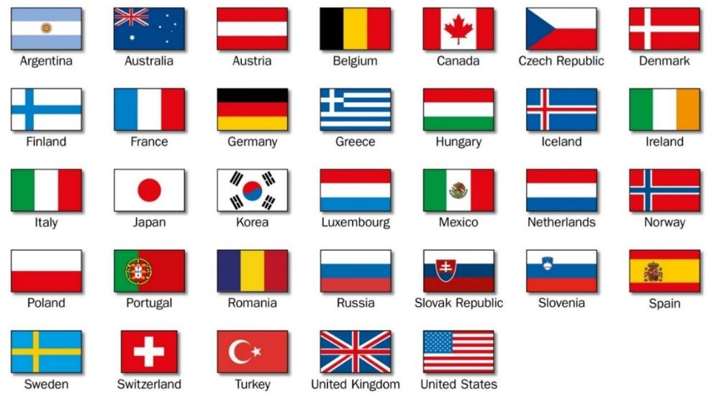
The NEA: 34 Countries Seeking Excellence in Nuclear Safety, Technology, and Policy
The premier international platform for cooperation in nuclear technology, policy, regulation, research, and education.
34 member countries + strategic partners (e.g., China and India).
More than 3000 experts from countries all over the world are participating in NEA activities.
Global relationships with industry and universities.
(suspended)
NEA countries operate about 81%
of the world's installed nuclear capacity

Slide 3
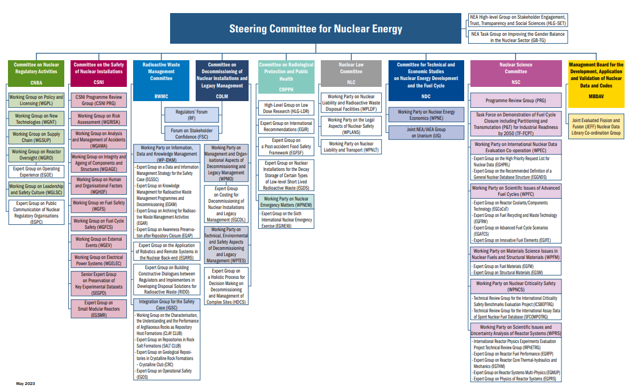
The NEA: International Nuclear Cooperation at Work
Structure of NEA Committees and Subsidiary Bodies

Slide 4
Major NEA International Co-operative Frameworks
NEA Serviced Bodies
Generation IV International Forum (GIF) with the goal to develop new fission technologies with greater sustainability (including effective fuel utilisation and minimisation of waste), economic performance, safety and reliability, proliferation resistance and physical protection.
Multinational Design Evaluation Programme (MDEP) - initiative by national safety authorities to leverage their resources and knowledge for new reactor design reviews (ABWR, AES2006, AP1000, EPR, HPR1000).
International Framework for Nuclear Energy Cooperation (IFNEC) – 65-country forum for multilateral discussion and analyses of a wide array of nuclear topics involving both developed and emerging economies.
28 Major Joint Projects
Nuclear safety research and experimental data (e.g., thermal-hydraulics, fuel behaviour, severe accidents).
Nuclear safety databases (e.g., fire, common-cause failures).
Nuclear science (e.g., thermodynamics of advanced fuels).
Radioactive waste management (e.g., thermochemical database).
Radiological protection (e.g., occupational exposure).
Nuclear Education, Skills and Technology Framework (NEST) (promoting the development of a new generation of subject matter experts).

Slide 5
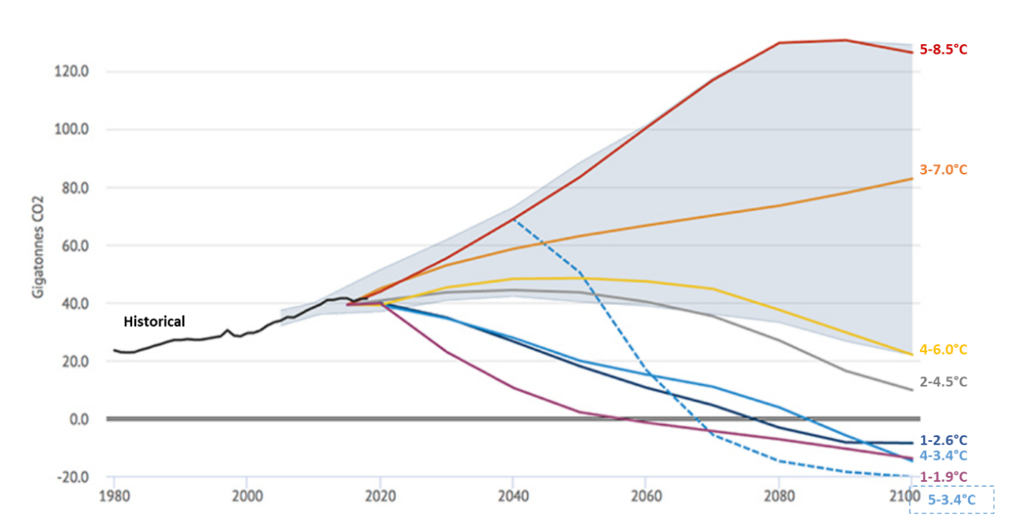
Global Action Is Urgently Needed to Meet Climate Targets
The magnitude of the challenge should not be underestimated
The planet has a “carbon budget” of 420 gigatonnes of carbon dioxide emissions for the 1.5°C scenario
At current levels of emissions, the entire carbon budget would be consumed within 8 years
Emissions must go to net zero, but the world is not on track
Temperature outcomes for various emissions futures
Source: Carbon Brief (2019).

Slide 6

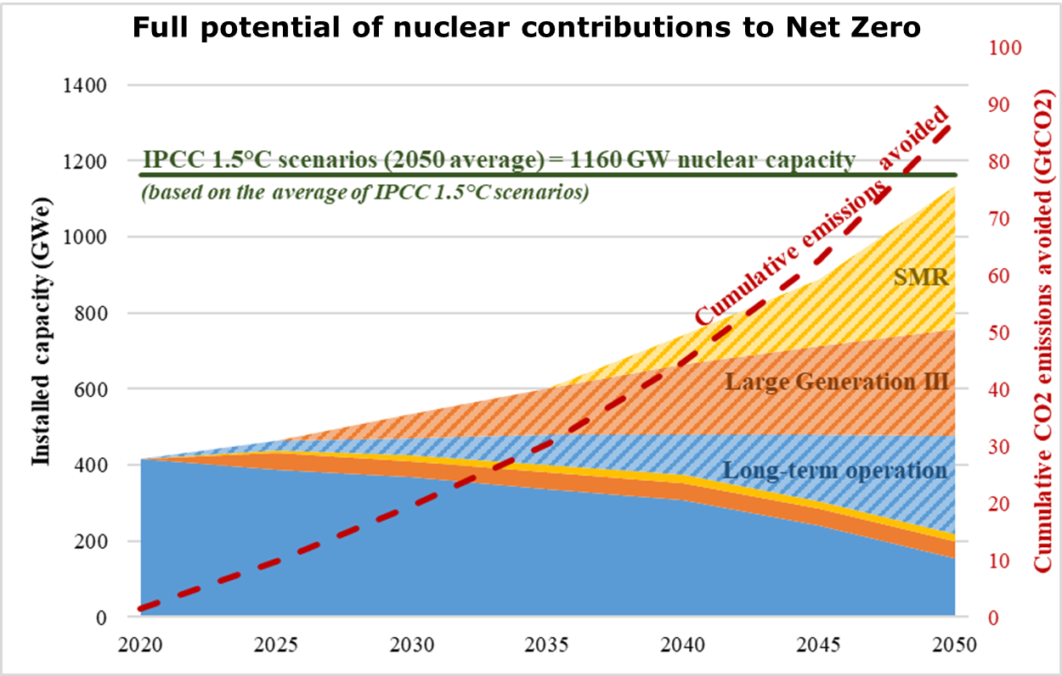
Strategic Energy Policy Context: Total global installed nuclear capacity needs to triple by 2050 for Net Zero
https://www.oecd-nea.org/jcms/pl_69396/meeting-climate-change-targets-the-role-of-nuclear-energy

Slide 7
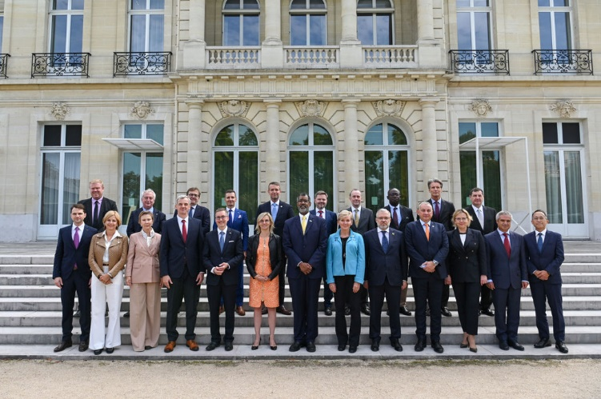
Roadmaps for New Nuclear Ministerial Meeting
Paris - September 28-29, 2023
In the lead-up to COP28, energy ministers from 20 countries issued a joint communiqué as a “call to action and guiding principles in support of roadmaps for nuclear energy” further “calling on the NEA to coordinate with stakeholders to develop […] solutions-oriented approach to support decision-makers in maximizing the full potential of nuclear energy”
This call to action was also echoed in an industry communiqué

Slide 8

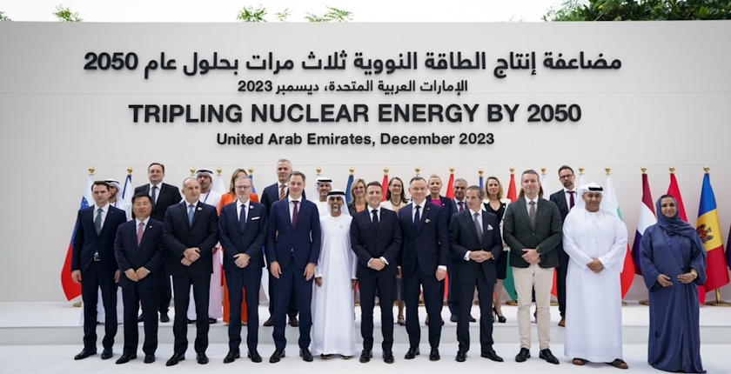
Commitment to Triple Nuclear Capacity by 2050
22 nations commit to tripling nuclear capacity by 2050
Reflects NEA analysis in “Meeting Climate Change Targets: The Role of Nuclear Energy”
Multinational Development Banks (MDBs) and International Developmental Finance Institutions (IFIs) in focus

Slide 9

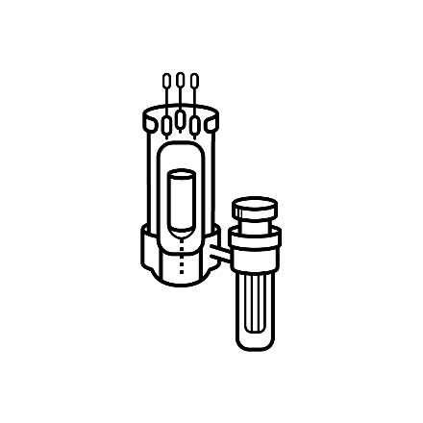




The Full Potential of Nuclear Energy to Contribute to Emissions Reductions
Complementary nuclear technologies and applications
H₂
Long Term Operation
Large Gen-III Reactors
Small Modular Reactors
Non-Electrical applications

Slide 10
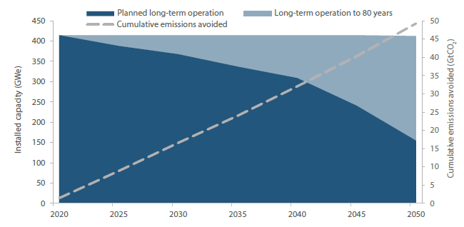
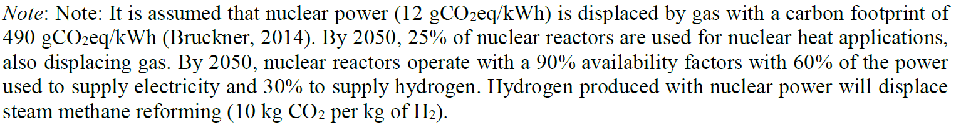
Long-term Operation of Current Nuclear Plants
Long-term operation – installed capacity and cumulative emissions avoided (2020-2050)
The average age of nuclear power plants in OECD countries is nearly 40 years
The technical potential exists in most cases for long-term operation for several more decades
Long-term operation is one of the most cost-competitive sources of low-carbon electricity
Adequate policy and market are key conditions of success of long-term operation
Long-term operation could save up to 49 gigatonnes of cumulative emissions between 2020 and 2050

Slide 11
Long-Term Operation is THE Least Cost Option
Challenges to LTO
Views of LTO vary around the world due to differing policy and regulatory approaches. For example in some countries, the 40 year mark is characterized as “plant lifetime.”
Distorted, dysfunctional, and obsolete markets do not recongnise the value of existing nuclear plants to system reliability and carbon reduction.
Some government policies are leading to the premature shut down of nuclear plants, placing Net Zero further out of reach.
LCOE by technology, 2025
Note: Coal includes lignite plants. Discount rate of 7% and carbon price of USD30/tCO2
Source: IEA/NEA (2020)
Long-term operation could save up to
49 gigatonnes of cumulative emissions
between 2020 and 2050.

Slide 12
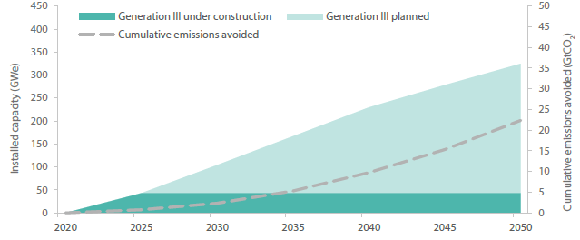
New Builds of Large Generation III Plants
At the end of 2020, 55 gigawatts of new nuclear capacity in the form of large-scale Generation III reactors were under construction around the world driven largely by new builds outside the current OECD membership
Taken together, large-scale Generation III reactors that are under construction and planned are expected to reach over 300 gigawatts of installed capacity by 2050, avoiding 23 gigatonnes of cumulative carbon emissions between 2020 and 2050
Generation III new builds – installed capacity and cumulative emissions avoided (2020-2050)

Slide 13
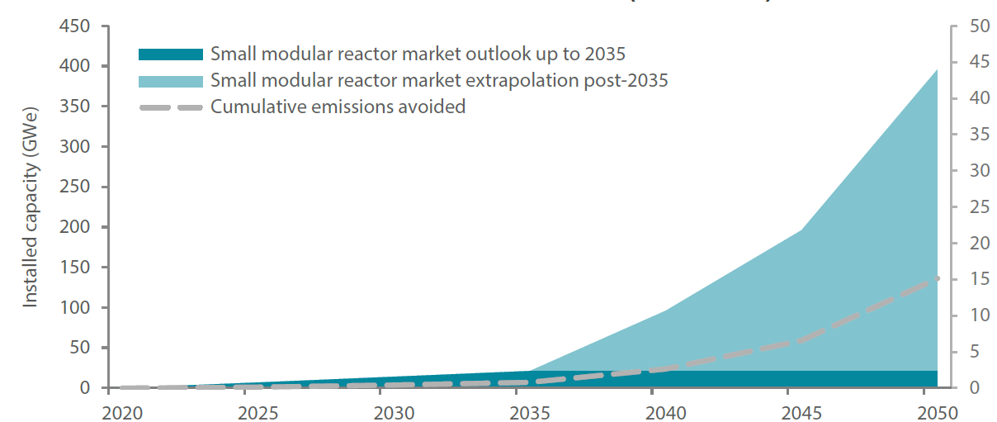
Small Modular Reactors and Generation IV Reactors
Several SMR designs are expected to be commercially deployed within 5-10 years and ready to contribute to near-term and medium-term emissions reductions
SMRs could see rapidly increasing rates of construction in net zero pathways
Up to 2035, the global SMR market could reach 21 gigawatts
Thereafter, a rapid increase in build rate can be envisaged with construction between 15 and 150 gigawatts per year
Installed Capacity And Cumulative Emissions Avoided

Slide 14
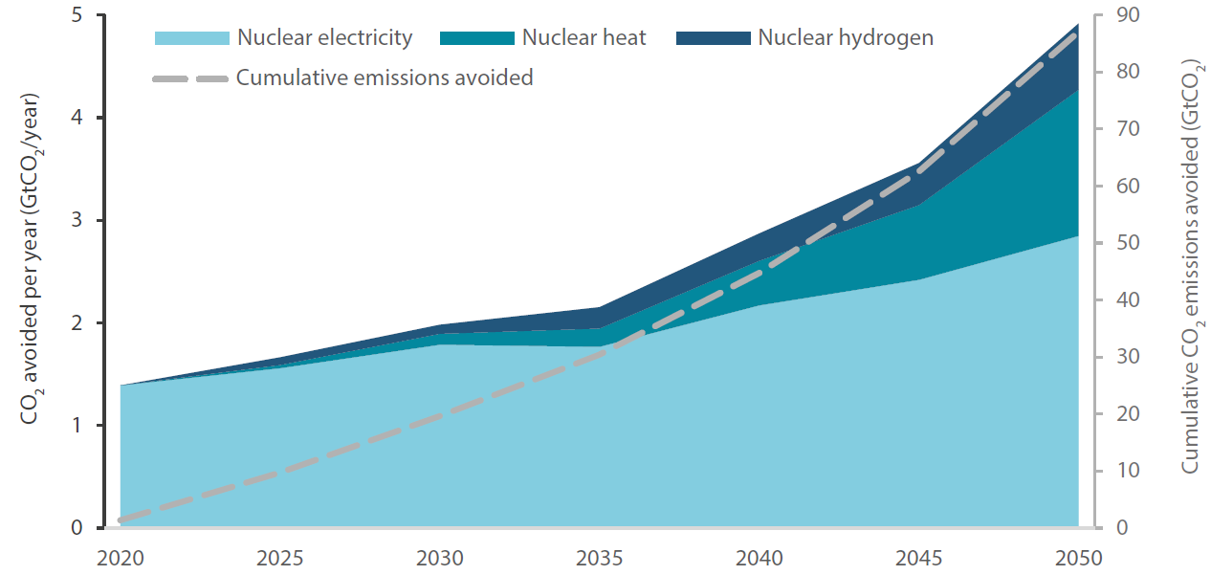
Power and Non-power Applications of Nuclear Energy
Taken together, nuclear hybrid systems with non-electric applications including hydrogen can contribute to avoiding nearly 23 gigatonnes of cumulative emissions between 2020 and 2050
Further, nuclear energy enables more extensive, more rapid, and more cost-effective deployment of variable renewables, by providing much needed flexibility
The role of nuclear energy in emissions reductions for future energy systems is therefore even greater
Carbon emissions avoided by nuclear power and non-power applications

Slide 15






Small Modular Reactors and Generation IV Reactors: Enabling Pathways to Net-Zero
SMALL MODULAR REACTORS (SMRs)
Small Smaller output Small physical size 1-300 MWe | Modular Factory Production Portable Scalable | Reactor Nuclear Fission Heat Electricity
BENEFITS
Simplified safety Lessons learned from 60 years of operations
Flexibility Adapted to complement variable renewables
APPLICATIONS
On-grid 200-300 MWe Replace coal | Merchant shipping Marine Production Off bunker fuel
Off-grid Remote sites Replace diesel | heat 285 – 850 °C Industrial cogeneration

Slide 16

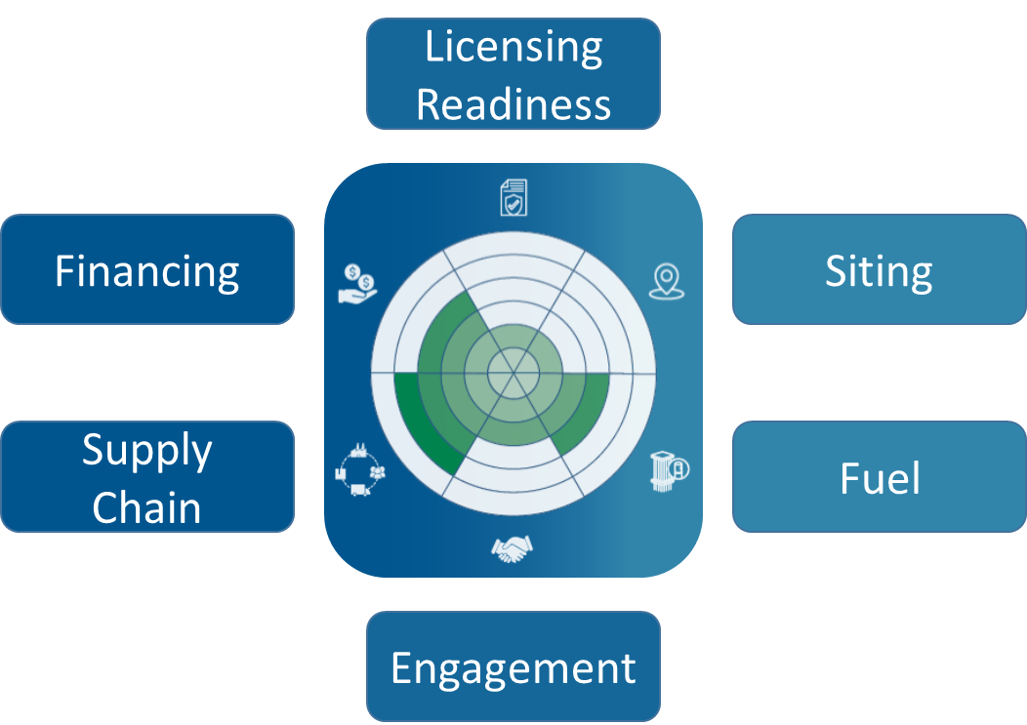

Tracking progress: NEA SMR Dashboard
“Technology readiness level” is useful, but only reveals part of the picture
NEA defined six additional indicators of progress
With the NEA indicators, the picture becomes clearer
Volume II published on Jul 20, 2023

Slide 17
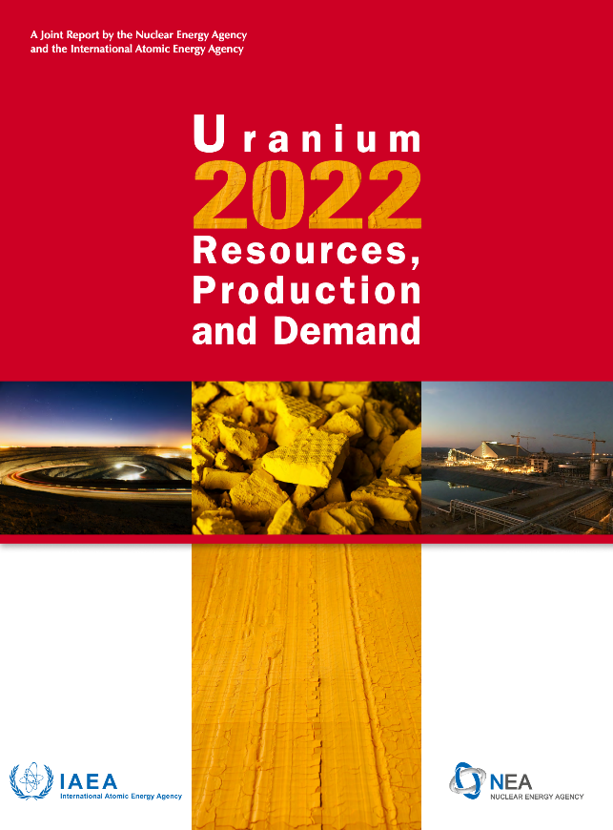
Red Book : Uranium Resources, Production and Demand
A biennial Joint report of NEA/IAEA
The world’s reference on the subject of uranium resources.
One of the most downloaded publications of the NEA website
Outlook: Known resources are more than sufficient for current nuclear capacity, but new exploration will be essential as more and more countries seek to deploy more nuclear plants.
Red Book 2024 currently in preparation

Slide 18
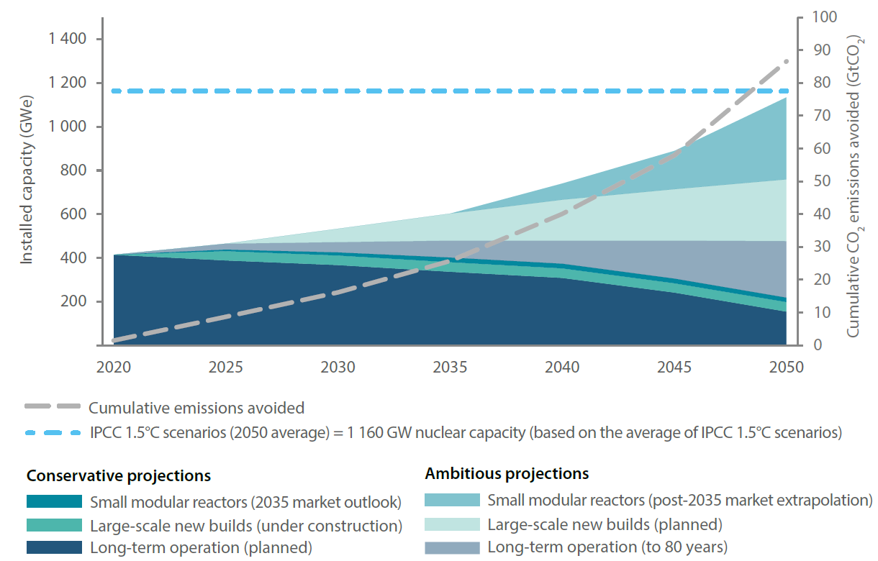
It is possible…
Reaching the target of 1160 gigawatts of global installed nuclear capacity by 2050 would require a combination of long-term operation, large-scale Generation III, SMRs, and non-electric applications such as nuclear-produced heat for desalinisation and hydrogen
Full potential of nuclear contributions to Net Zero

Slide 19
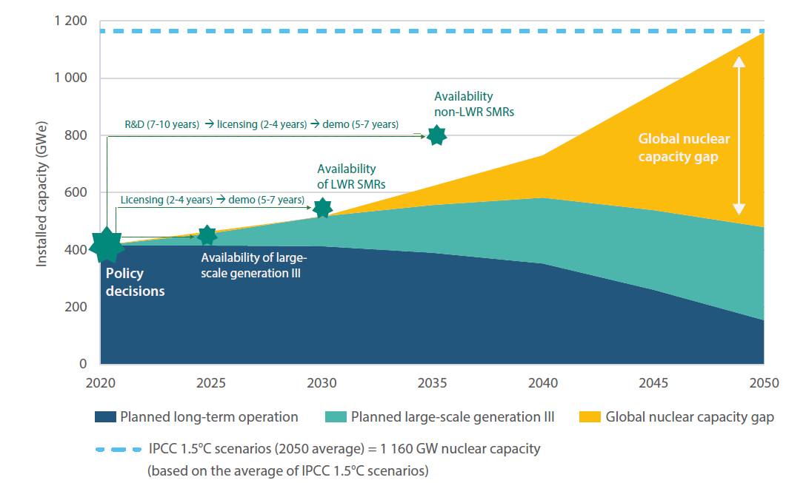
…But We are Not on Track toward Success
Under current policy trends, nuclear capacity in 2050 is expected to reach 479 gigawatts – well below the target of 1160 gigawatts of electricity
Owing to the timelines for nuclear projects, there is an urgency to action now to close the gap in 2030-2050
Global installed nuclear capacity gap (2020-2050)

Slide 20
For New Nuclear Energy to be Successful, Key Challenges Must be Addressed
Industrial Challenges
Regulatory Challenges
Policy and Market Challenges
Infrastructure Challenges

Slide 21
For New Nuclear Energy to be Successful, Key Challenges Must be Addressed
Industrial Challenges
Execution—industry must take breakthrough technologies from the drawing board to commercial reality and deliver projects as promised
Operations Models—industry must present realistic models to operate large numbers of SMRs and microreactors
Supply Chain—past experience demonstrates that the global nuclear supply chain is neither broad nor deep and suppliers are not always as prepared as might be expected

Slide 22
For New Nuclear Energy to be Successful, Key Challenges Must be Addressed
Regulatory Challenges
Adaptation to New Technologies—regulators must not view Gen IV technologies through a Gen II lens and must be prepared to address digital technologies
Global Thinking—regulators must act nationally but think globally; otherwise there cannot be a true global market for new technologies
Accept New Paradigms—new technologies may be game-changers in areas such as EP and security, but regulators must be truly risk-informed

Slide 23
For New Nuclear Energy to be Successful, Key Challenges Must be Addressed
Policy and Market Challenges
Outdated Electricity Markets—today’s markets don’t support long-term environmental and energy security goals; dispatchability has value!
FOAK—governments must put policies in place to address FOAK risks; industry cannot/will not absorb all the risks
Financing—government policies are needed to support financing of new nuclear construction and other high-capital investments needed to reach Net-Zero

Slide 24
For New Nuclear Energy to be Successful, Key Challenges Must be Addressed
Infrastructure Challenges
HALEU—the lack of a clear path to provide high assay LEU is already a barrier to new technologies
Codes and Standards—industry, governments, regulators and other stakeholders must commit to strive toward simplified and harmonised nuclear standards
Human Resources—more must be done to promote a new generation of nuclear experts while promoting greater diversity and gender balance

Slide 25
Challenges and Successful Strategies to Attracting More Nuclear Engineers
Challenges
Low knowledge of the nuclear sector.
Unclear national political decisions and lack of long term goals (in some countries).
Challenging demographic situation (in some countries).
Complex curricula compared to other disciplines.
Insufficient competitiveness of salaries (in some countries).
Gender and inclusiveness gaps.
Successful strategies
Policy-level shifts toward nuclear energy.
Clear national roadmaps, systems and resources for training and workforce development.
Improved communication, including via better use of social media, more role models.
More innovative curricula.
Engagement with high schools (students, educators and parents) to build pipeline of STEM talents to the nuclear sector.
Improved gender balance and inclusiveness.
International collaboration and networking.
What motivates young people to study nuclear engineering?
“The desire to be useful to society” and “to prove that the nuclear energy is safe and reliable”.

Slide 26
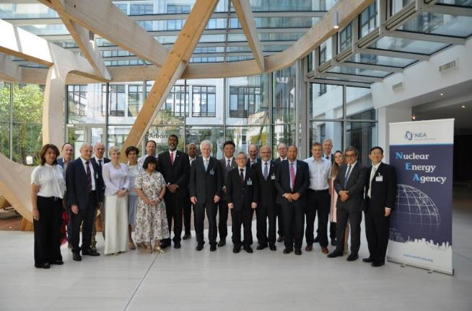
Global Forum on Nuclear Education, Science, Technology and Policy
Provides academic institutions around the world with a framework for interaction, co-operation, and collective action
The Global Forum is led by the Council of Advisors: 35 members from 21 academic and research organisations from Australia, Belgium, Canada, Germany, France, Italy, Japan, Korea, the United Kingdom, and the United States.
Currently chaired by MIT Vice Provost Richard Lester
Active Working Groups
Achieving Gender Balance in Nuclear Technology and Academic Workforces
Defining the Future of Nuclear Engineering Education
Rethinking the Relationship Between Nuclear Energy and Society
Revitalising Innovation in the Nuclear Sector to Improve the Future Competitiveness of Nuclear Energy
Rebuilding Expertise in Nuclear Law
Since 2021, the Global Forum has used creative problem-solving to help confront some of the most significant challenges in nuclear education and human capacity.
Most recently, the Global Forum has supported country-specific workshops in Japan, Romania and the Republic of Korea that enabled dialogue between academia, government, and the nuclear industry to overcome barriers to nuclear education and to outline scenarios for its future.
26

Slide 27

Global Forum on Nuclear Education, Science, Technology and Policy
Another Recent Event: Global Forum Rising Stars Workshop, Sept. 2023, hosted by MIT
40 female graduate students & post-doctoral researchers from all over the world
Career development and mentoring, student presentations and discussions
The next Global Forum Rising Stars Workshop will be held mid-2024 in Korea!
Email RisingStars@oecd-nea.org to be notified when nomination process opens
27

Slide 28
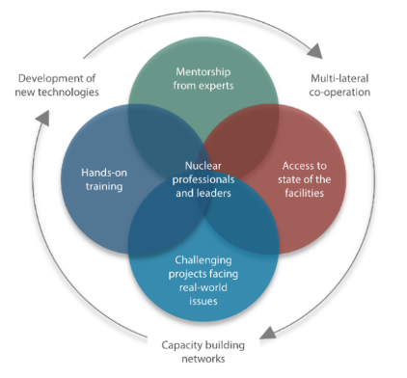











Nuclear Education, Skills and Technologies (NEST) Framework
A multinational framework to maintain & build skills and to nurture the next generation of nuclear subject matter experts through transfer of practical experience and knowledge
Participating countries: Belgium, Canada, France, Germany, Italy, Japan, Korea, Romania, Switzerland and USA
Develops skills and competences and transfers knowledge through hands-on training in the course of challenging nuclear projects
Builds a talent pipeline from universities, to industries, regulators and TSOs
Enables student access to scientific infrastructure, construction projects, and decommissioning activities
Three new countries will join NEST over the next few months.
SMRs
Safety
Research Reactors
Robotics for Decommissioning
Thermodynamics of severe accidents
Nuclear Medicine
Legacy waste
management
i-graphite
RWM
57 Organisations
208 Fellows over the life of the current projects
www.oecd-nea.org/nest

Slide 29
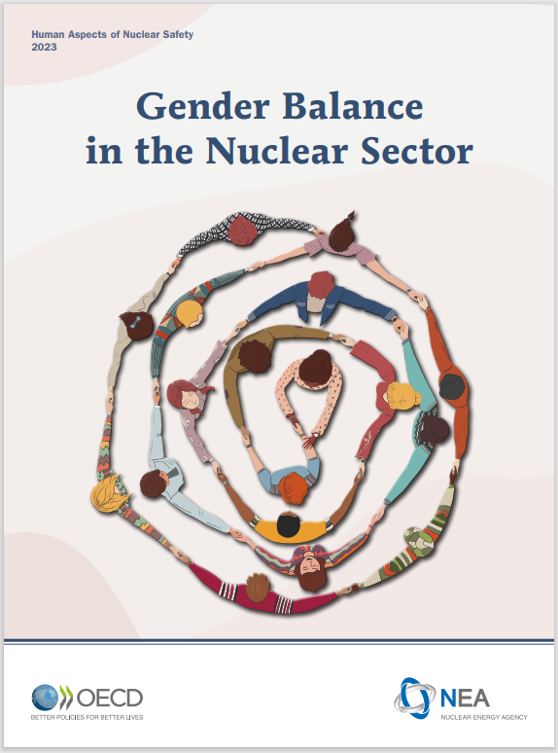
NEA Work towards Gender Balance in the Nuclear Sector
Flagship Report Launched on 8 March 2023
Takes stock of current gender balance in nuclear sector in NEA countries
Provides first public, international data
Objective: To establish policy framework with recommendations.
Recommendation on Improving the Gender Balance in the Nuclear Sector adopted by 38 countries on 8 June 2023
‘Attract, Retain & Advance + Data’ Framework
Attract
women into the nuclear sector
Retain
& support women in the workforce
Advance
& develop women as leaders
Download the report: http://www.oecd-nea.org/gender-balance
DATA REPORTING & ACCOUNTABILITY

Slide 30

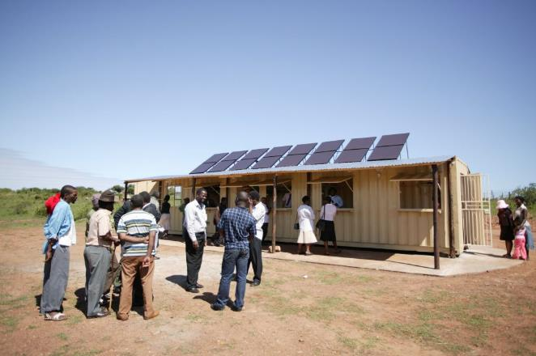
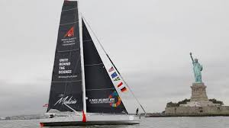
For Climate Action to be Successful, An Enhanced Vision of the Future is Needed
If action on climate is associated with limits to life, economic growth, and freedom, a successful energy transition will be difficult.
Innovative Nuclear Technologies Help Provide a Solution Set

Slide 31
Thank you for your attention!

