Slide 1
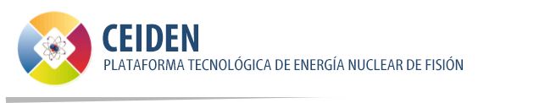



ANTILoPE:
A NeuTron multifoIL sPEctrometer
Pablo Pérez-Maroto, Carlos Guerrero & José M. Quesada
On behalf of Universidad de Sevilla, CIEMAT & the n_TOF local team
CEIDEN-GUN meeting. 09/06/2022

Slide 2
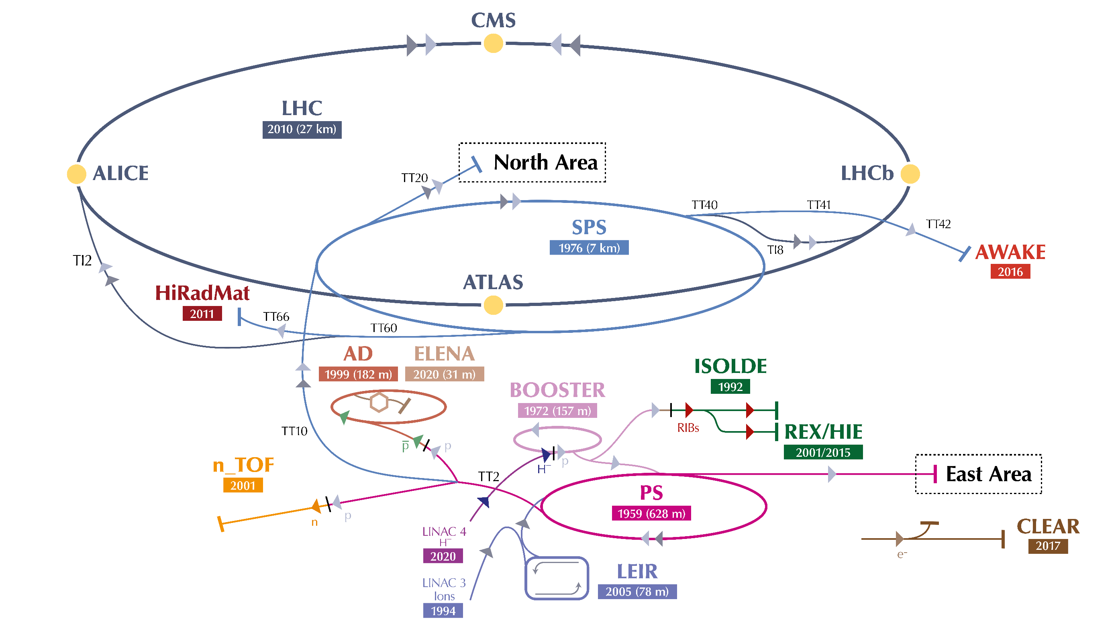
A new experimental area at n_TOF@CERN: NEAR
Neutron Time Of Flight
In operation since 2001
2022: 131 researchers from 37 institutes
Pablo Pérez Maroto || CEIDEN-GUN Meeting || 09/06/2022

Slide 3
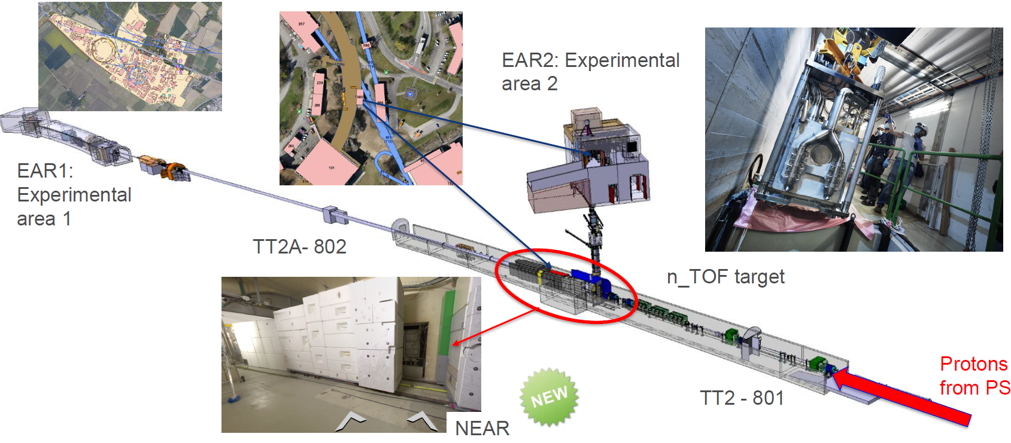
A new experimental area at n_TOF@CERN: NEAR
A.P. Bernardes
Pablo Pérez Maroto || CEIDEN-GUN Meeting || 09/06/2022

Slide 4
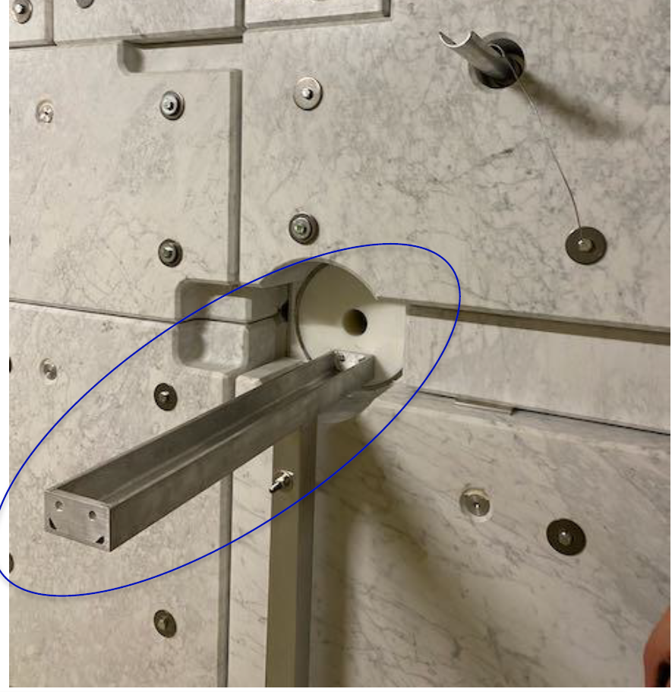
A new experimental area at n_TOF@CERN: NEAR
Perfect for activation measurements, radiation damage tests…
NEAR is under commissioning at the moment
Need to develop passive detectors:
  Huge doses inside the room -> long irradiations with no access + cooldown time (now more flexible)
  No cables in/out the room
  No active detectors could survive the flux! (for the moment)
Collimator
Neutrons
A.P. Bernardes
Pablo Pérez Maroto || CEIDEN-GUN Meeting || 09/06/2022

Slide 5
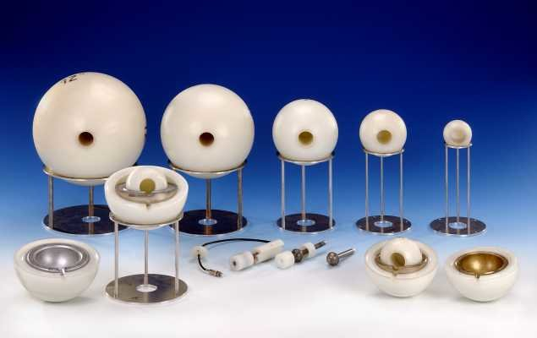
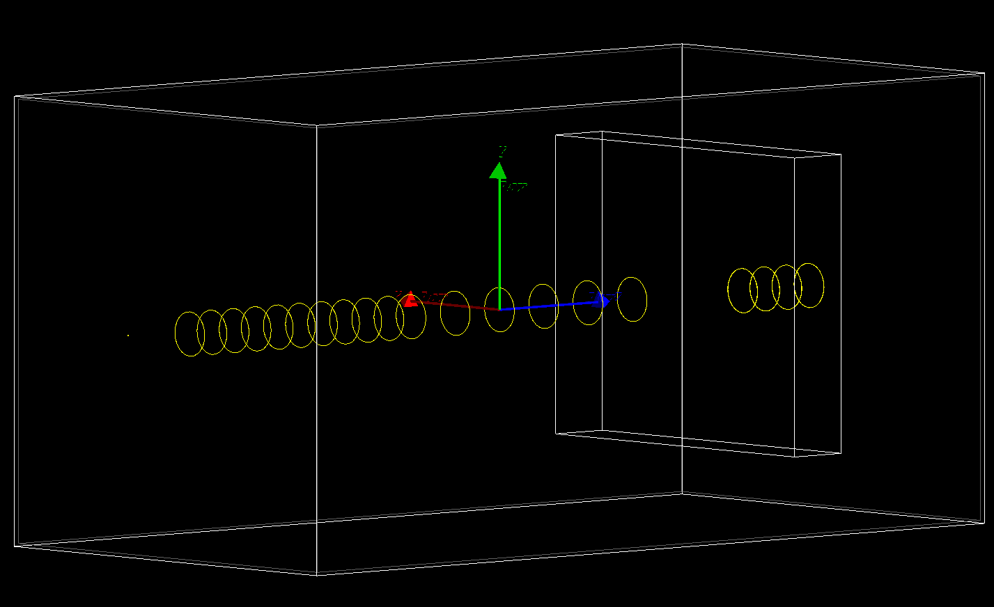
A neutron multi-foil spectrometer for NEAR
ANTILoPE design according to NEAR experimental conditions
Based on neutron moderation + capture -> unfolding of the flux
(Passive) Bonner Spheres
ANTILoPE
Pablo Pérez Maroto || CEIDEN-GUN Meeting || 09/06/2022

Slide 6
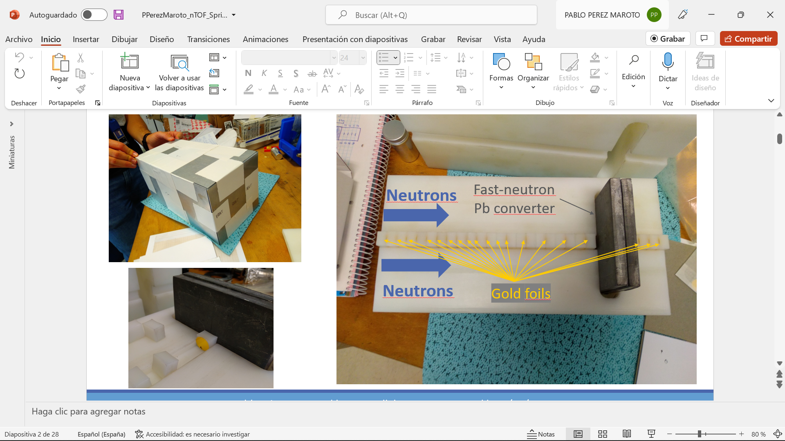
A neutron multi-foil spectrometer for NEAR
30x30x15cm PE block to moderate the neutrons
Gold foils at different positions to capture the moderated neutrons
Pb block to improve the sensitivity to very fast neutrons
Pablo Pérez Maroto || CEIDEN-GUN Meeting || 09/06/2022

Slide 7
A neutron multi-foil spectrometer for NEAR
1 mm Cd layer
Pablo Pérez Maroto || CEIDEN-GUN Meeting || 09/06/2022

Slide 8
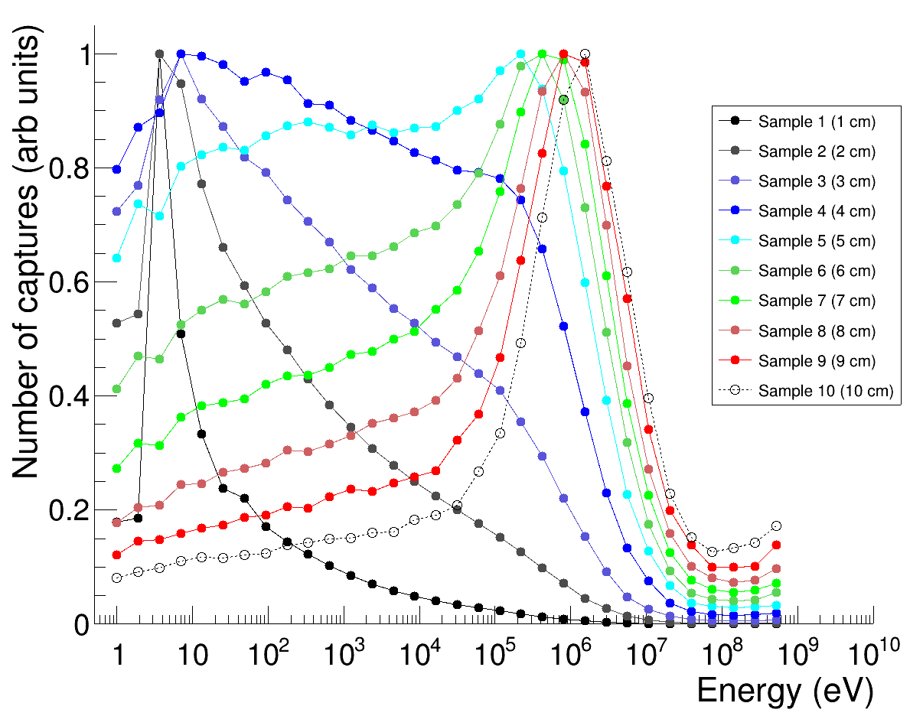
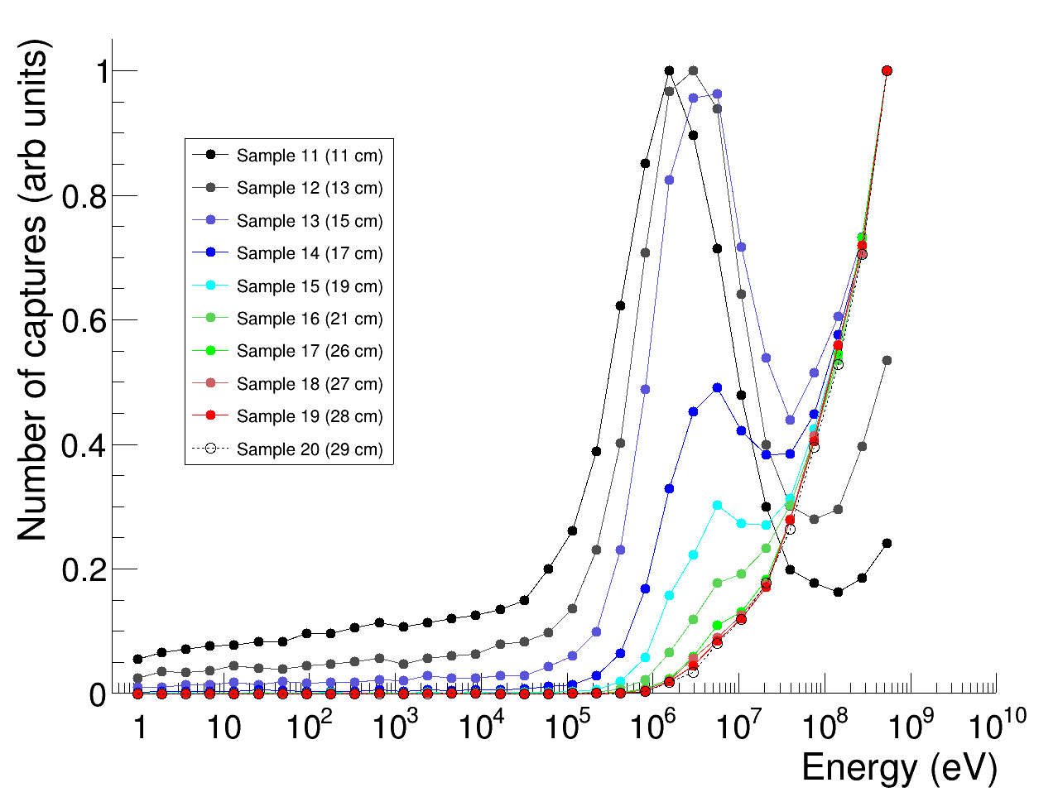
ANTILoPE response matrix with GEANT4
ANTILoPE irradiated at NEAR on Octuber 2021
Gold samples’ activity measured with Usevilla’s LaBr3 + CAEN digitizer
Analysis ongoing with CERN’s RooUnfold
Pablo Pérez Maroto || CEIDEN-GUN Meeting || 09/06/2022

Slide 9
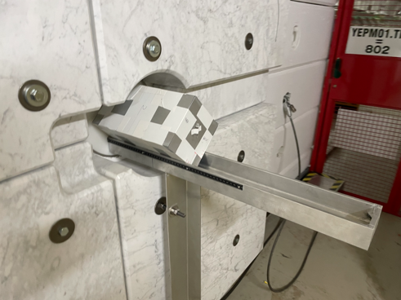
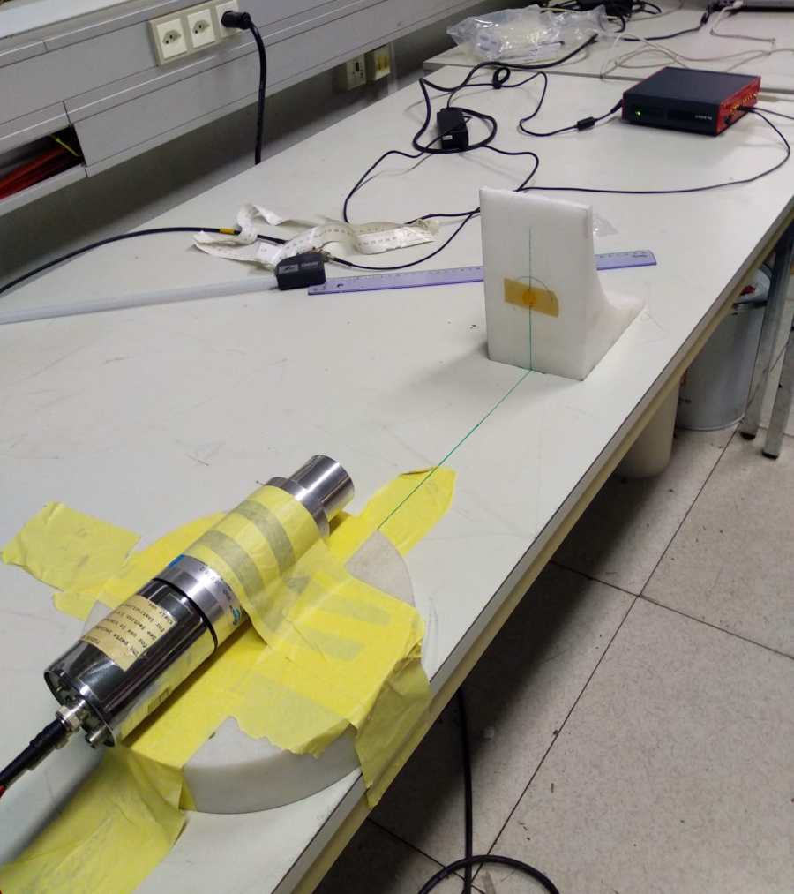
ANTILoPE response matrix with GEANT4
ANTILoPE irradiated at NEAR on Octuber 2021
Gold samples’ activity measured with Usevilla’s LaBr3 + CAEN digitizer
Analysis ongoing with CERN’s RooUnfold
Pablo Pérez Maroto || CEIDEN-GUN Meeting || 09/06/2022

Slide 10
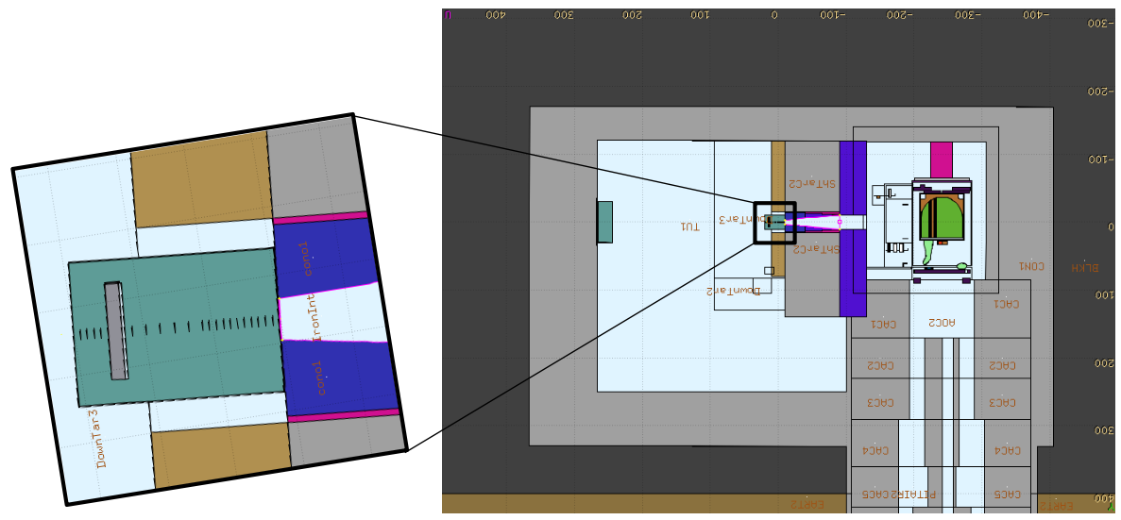
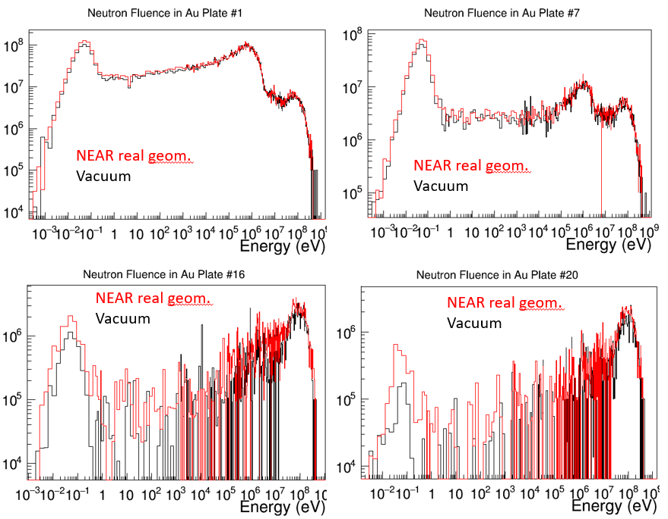
Expected activation -> FLUKA simulations
We observed discrepancies in the measured activation. The cadmiun was not enough?
Simulations with FLUKA of ANTILoPE in vacuum & inside bunker
Correction applied to experimental data
J.A. Pavón & M. Sabaté
Pablo Pérez Maroto || CEIDEN-GUN Meeting || 09/06/2022

Slide 11
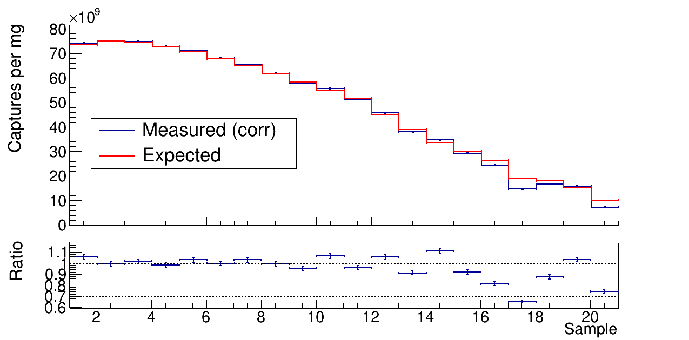
Expected activation -> FLUKA simulations
±5%
Pablo Pérez Maroto || CEIDEN-GUN Meeting || 09/06/2022

Slide 12
Understanding RooUnfold
Pablo Pérez Maroto || CEIDEN-GUN Meeting || 09/06/2022

Slide 13
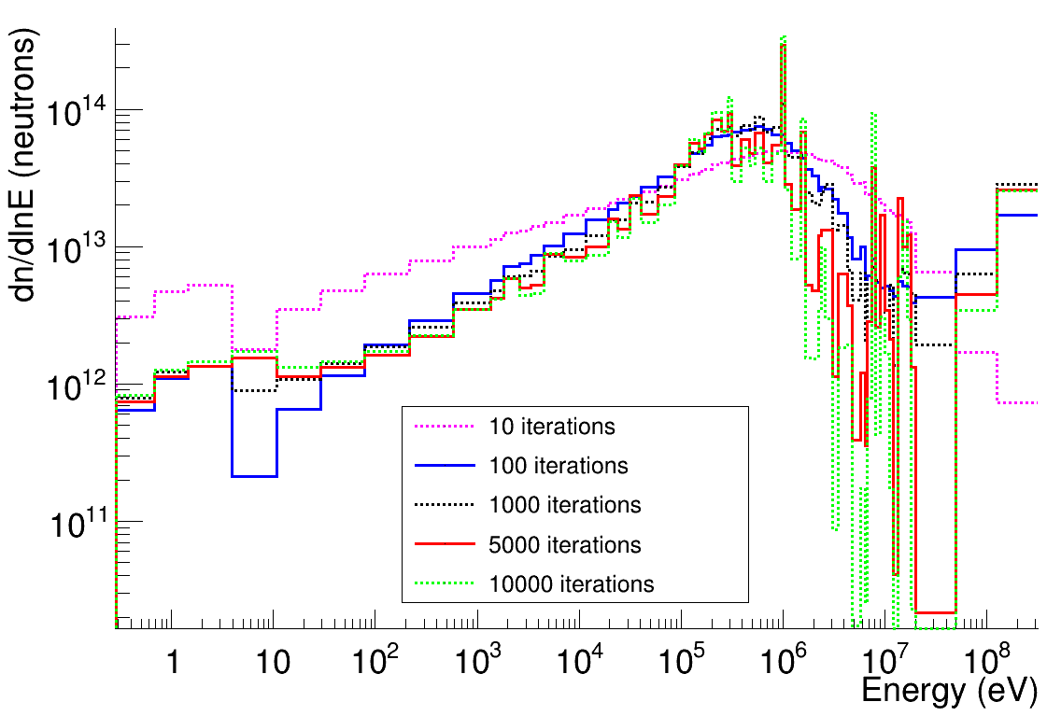
Understanding RooUnfold -> Nº of iterations
Stabilization of the eV-MeV range after 100 iterations
Large fluctuations in the above 1 MeV range, optimum choice?
Pablo Pérez Maroto || CEIDEN-GUN Meeting || 09/06/2022

Slide 14
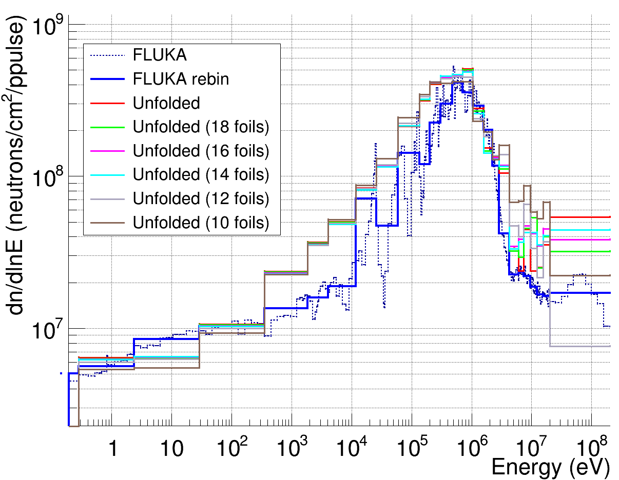
Understanding RooUnfold -> Nº of foils
Removal of up to 10 downtream foils affects only above 5 MeV, and very significantly above 20 MeV
Pablo Pérez Maroto || CEIDEN-GUN Meeting || 09/06/2022

Slide 15
Understanding RooUnfold
With an excessively large number of iterations fluctuations appear in the last bins (1 MeV – 1 GeV)
Removing foils from the matrix also affects this part of the spectrum -> these foils does not affect the 1 eV – 5 MeV range
The unfolded flux does not change with the initial guess
Possible dependence with the binning observed
Use of other unfolding codes pending
Pablo Pérez Maroto || CEIDEN-GUN Meeting || 09/06/2022

Slide 16

Understanding RooUnfold
With an excessively large number of iterations fluctuations appear in the last bins (1 MeV – 1 GeV)
Removing foils from the matrix also affects this part of the spectrum -> these foils does not affect the 1 eV – 5 MeV range
The unfolded flux does not change with the initial guess
Possible dependence with the binning observed
Use of other unfolding codes pending
We need to understand better how the unfolding works!
Pablo Pérez Maroto || CEIDEN-GUN Meeting || 09/06/2022

Slide 17
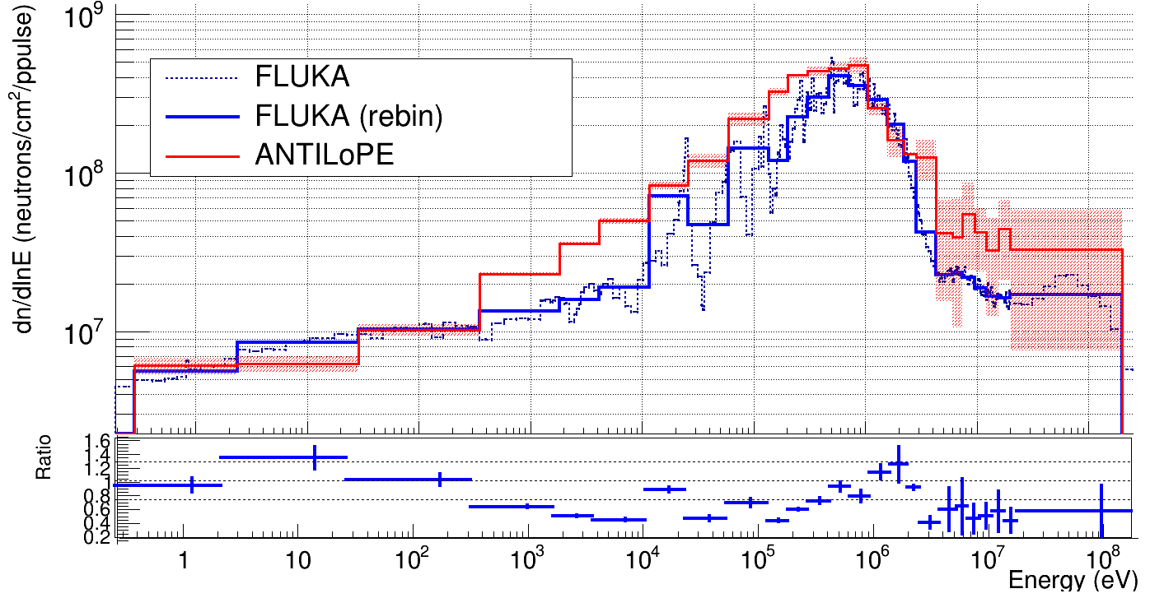
NEAR flux with ANTILoPE
Pablo Pérez Maroto || CEIDEN-GUN Meeting || 09/06/2022

Slide 18
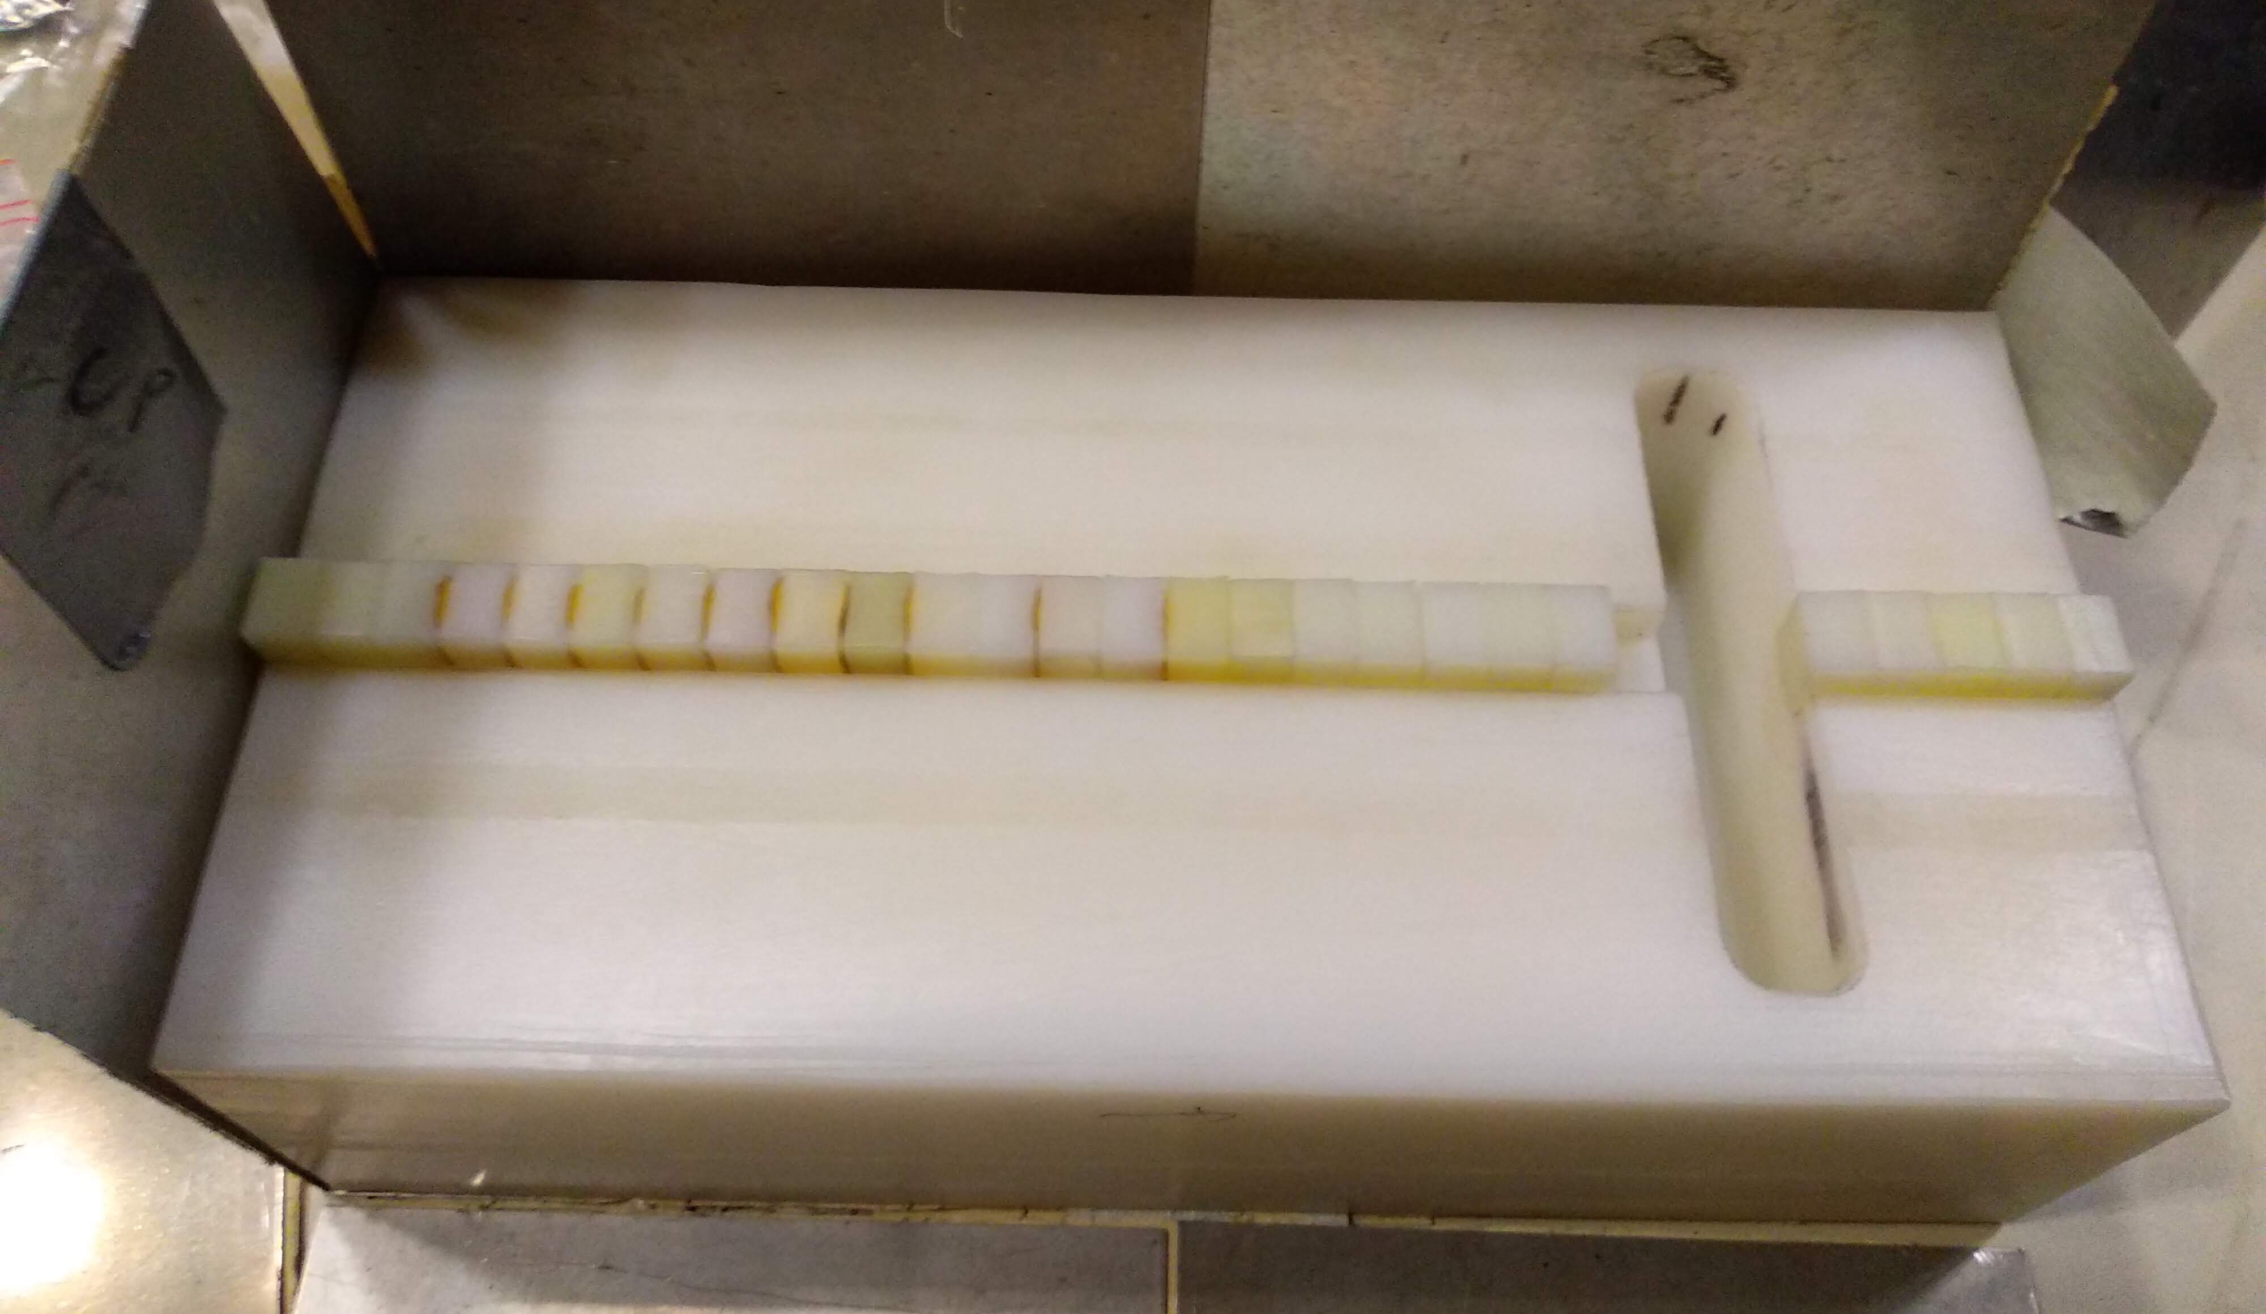
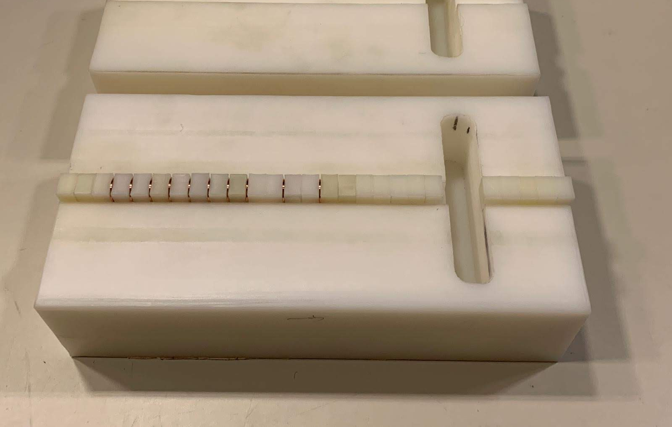
Simplified design test at HISPANoS@CNA
Changes in the set-up
No need for the Pb converter
Removal of the first 2 foils and the last 8
Test of target material: the strong 5 eV
¹⁹⁷Au resonance may make gold not an optimal choice -> test of Cu for producing
⁶⁴Cu (β⁺; 12,7h)
Goals:
Irradiate with epitermal (1-100 keV) and mono-energetic fast (4,6 MeV) fluxes to test the sensibility of ANTILoPE
20 um Au foils
1 mm Cu foils
Pablo Pérez Maroto || CEIDEN-GUN Meeting || 09/06/2022

Slide 19
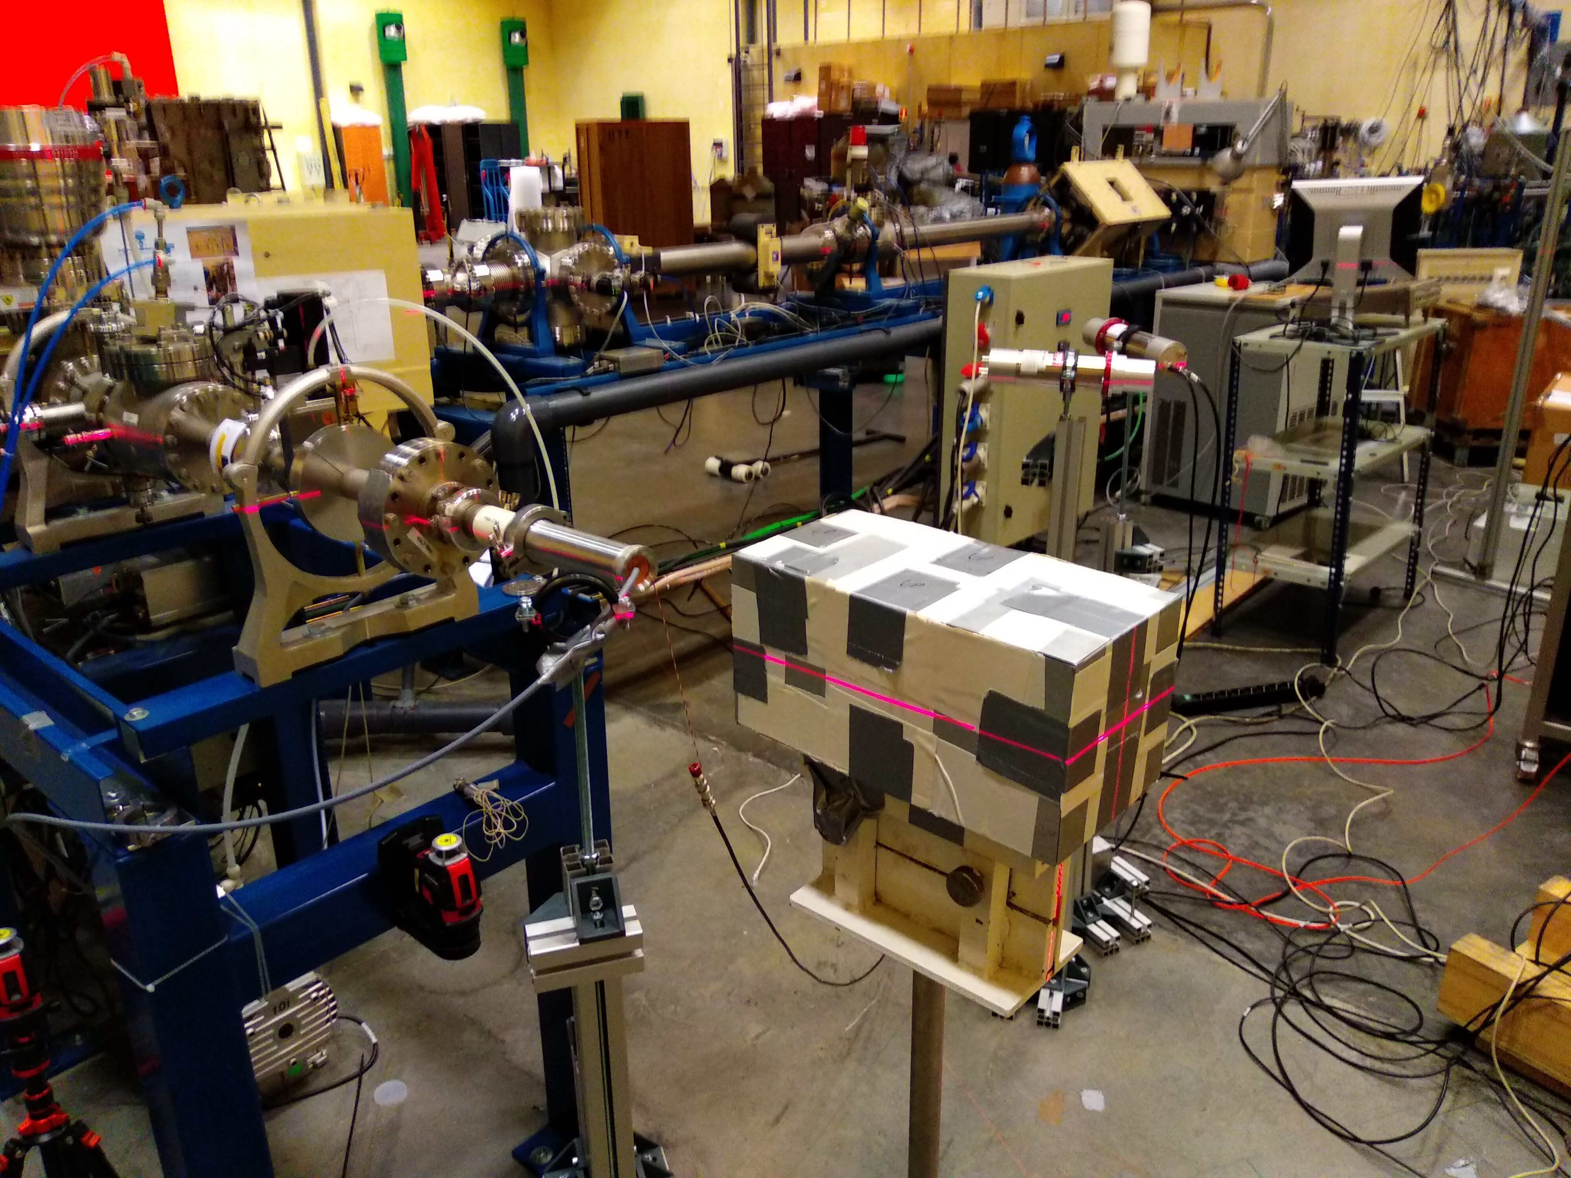
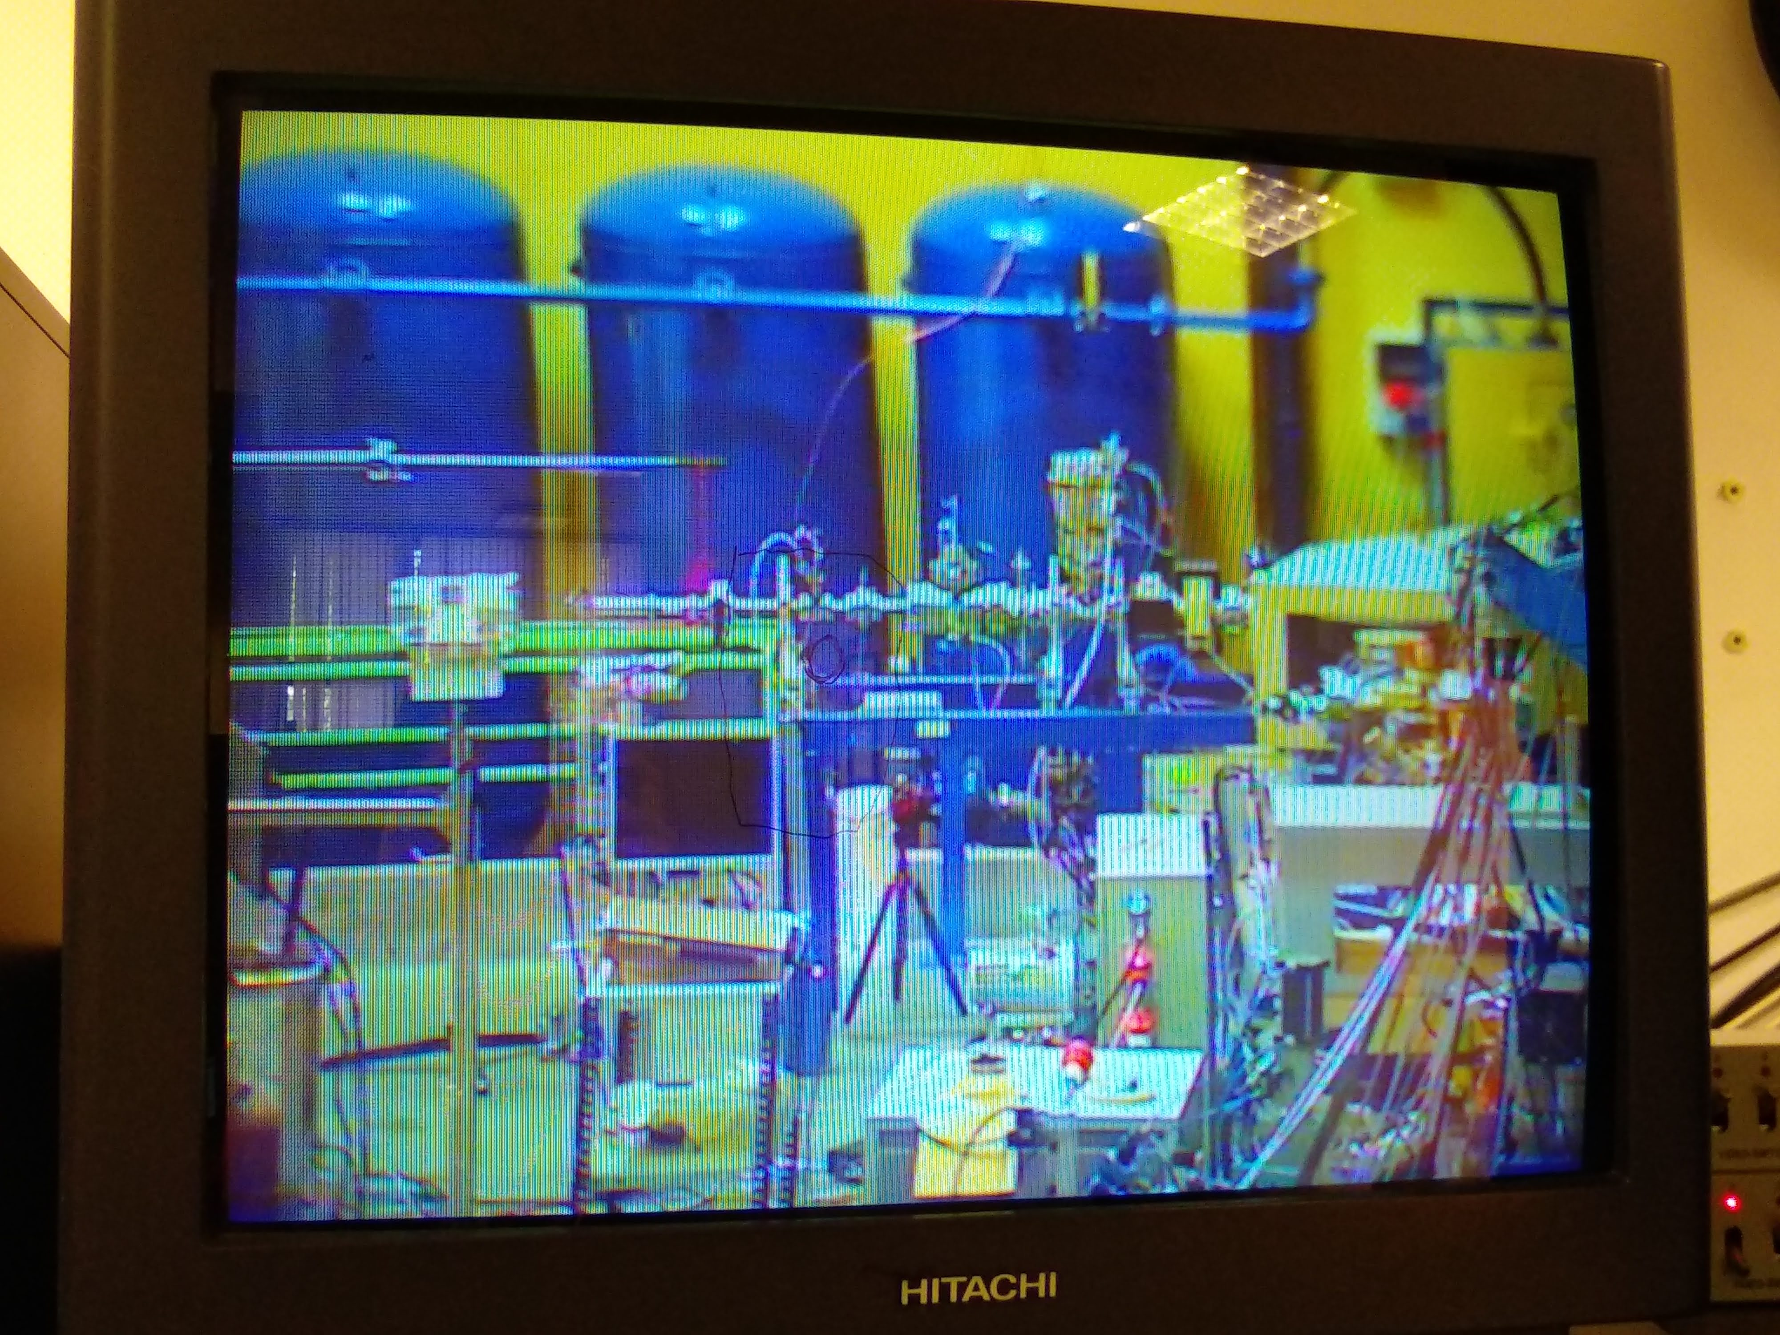
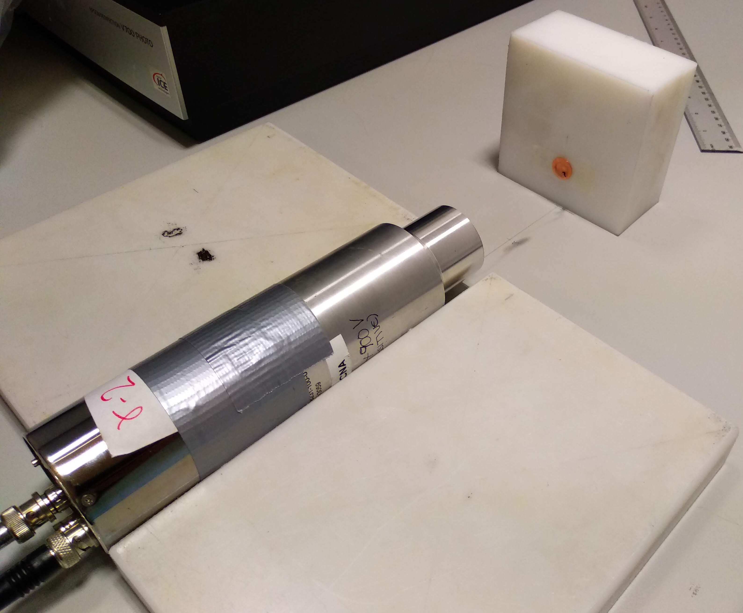
Simplified design test at HISPANoS@CNA
Changes in the set-up
No need for the Pb converter
Removal of the first 2 foils and the last 8
Test of target material: the strong 5 eV
¹⁹⁷Au resonance may make gold not an optimal choice -> test of Cu for producing
⁶⁴Cu (β⁺; 12,7h)
Goals:
Irradiate with epitermal (1-100 keV) and mono-energetic fast (4,6 MeV) fluxes to test the sensibility of ANTILoPE
Pablo Pérez Maroto || CEIDEN-GUN Meeting || 09/06/2022

Slide 20
Summary & Conclusions
ANTILoPE: designed in 2021 for measuring the neutron flux at NEAR
Measurements were succesfully perfomed last year
FLUKA simulations of NEAR flux => estim./meas. # captures agree within ±5%
Effect of the scattered neutrons with FLUKA => affects the E_{n}>10 MeV mainly
Effect of the choice of # iterations and # foils: reasonable results
Study of binning dependence: ongoing
Test others unfolding codes pending: coming son
A better unfolding of the flux is for sure possible
Meanwhile, simplified design and irradiation at HiSPANoS@CNA
  Epithermal neutrons (1912 keV proton on LiF target): quasimaxwellian of ~ 30 keV
  Mono-energetic fast neutrons (d-D producing 4,6 MeV neutrons)
  Analysis ongoing
Pablo Pérez Maroto || CEIDEN-GUN Meeting || 09/06/2022

Slide 21
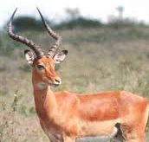
Thank you!
Pablo Pérez Maroto
ppmaroto@us.es
Pablo Pérez Maroto || CEIDEN-GUN Meeting || 09/06/2022

Slide 22
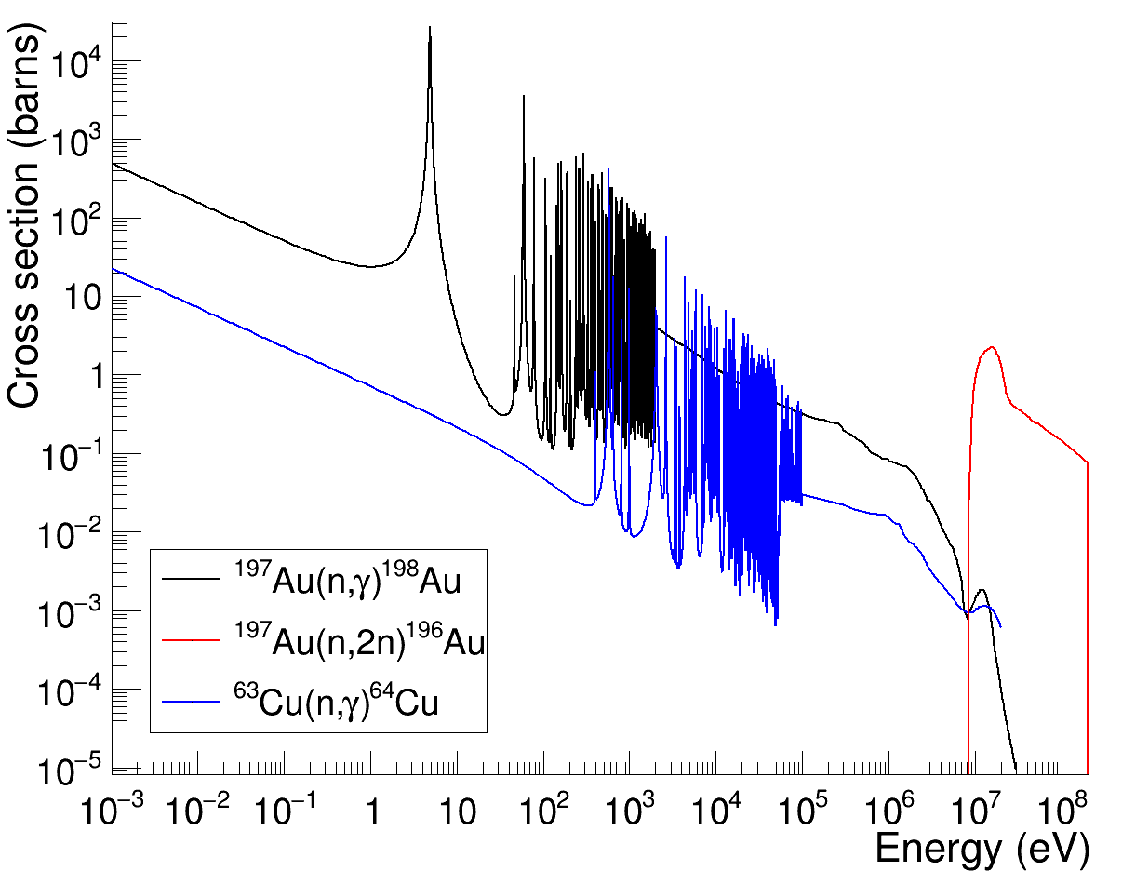
Backup. Cross sections
Pablo Pérez Maroto || CEIDEN-GUN Meeting || 09/06/2022

Slide 23
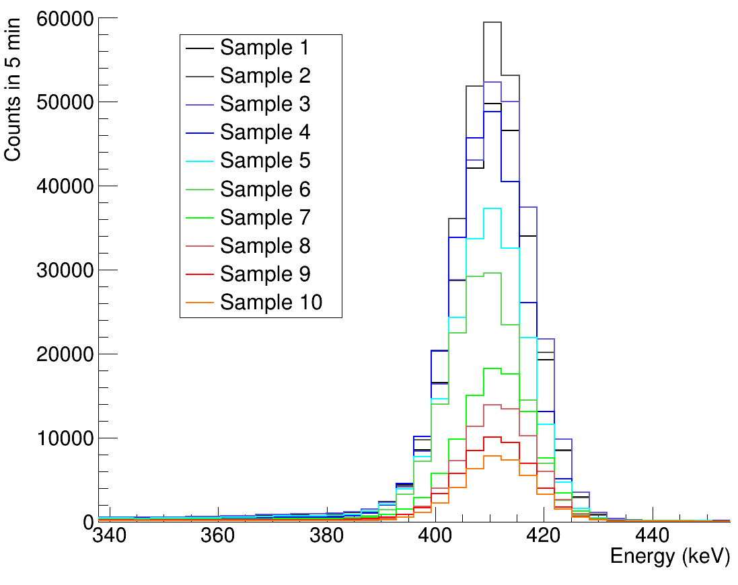
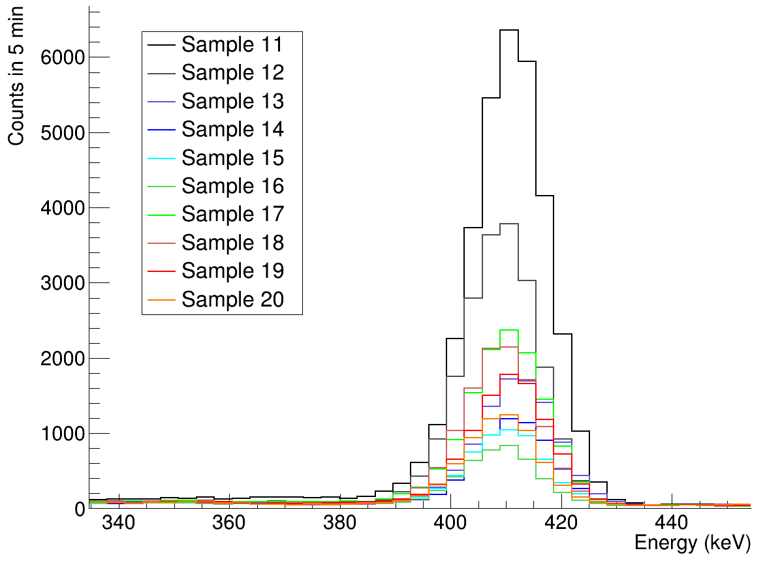
Backup. Activity
Pablo Pérez Maroto || CEIDEN-GUN Meeting || 09/06/2022

Slide 24
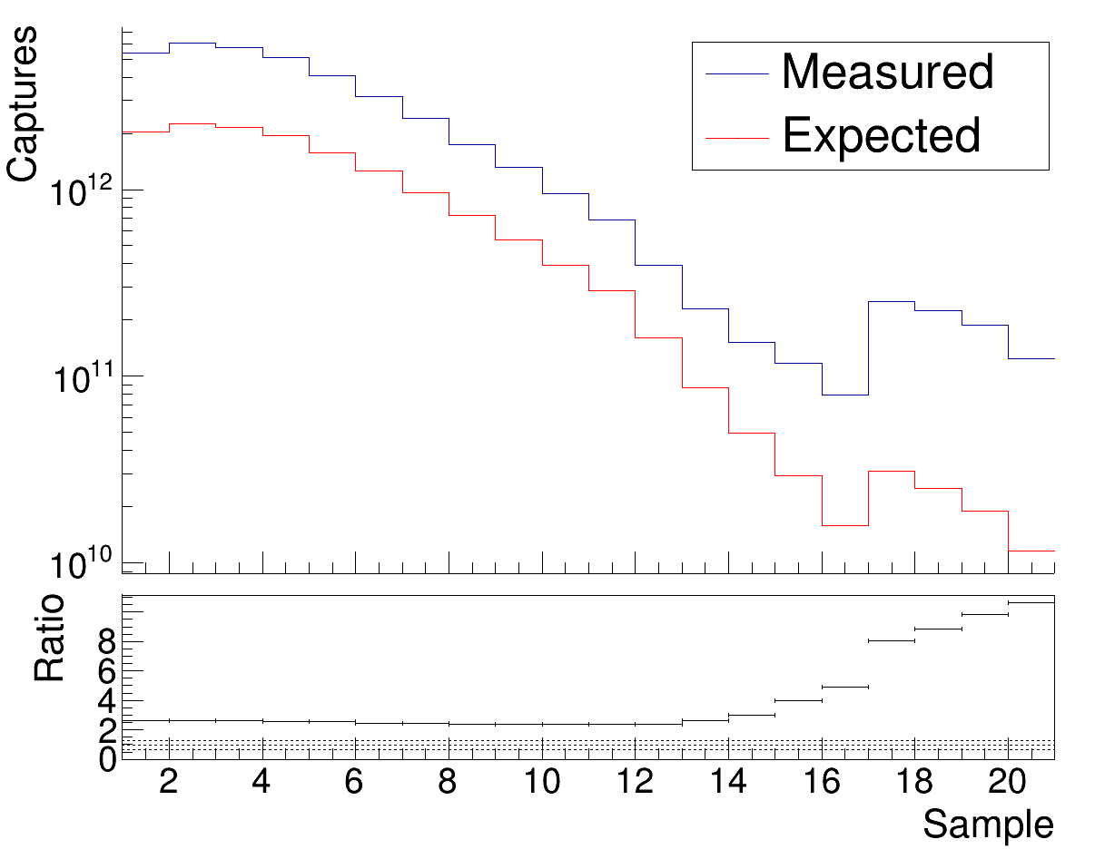
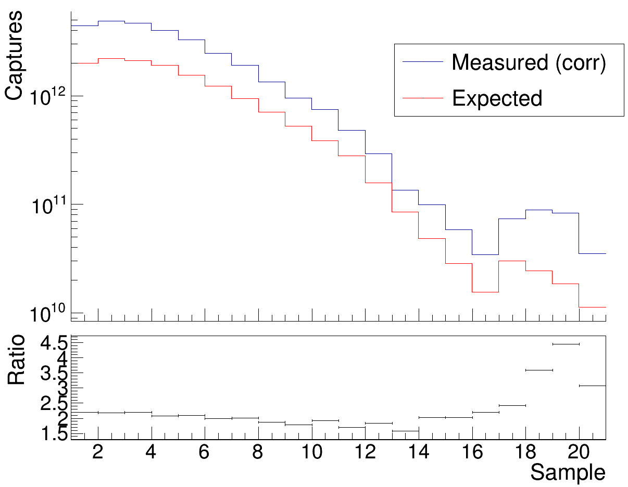
Backup. Correction due to scattering
Correction by the contribution of scattered neutrons
Pablo Pérez Maroto || CEIDEN-GUN Meeting || 09/06/2022

Slide 25
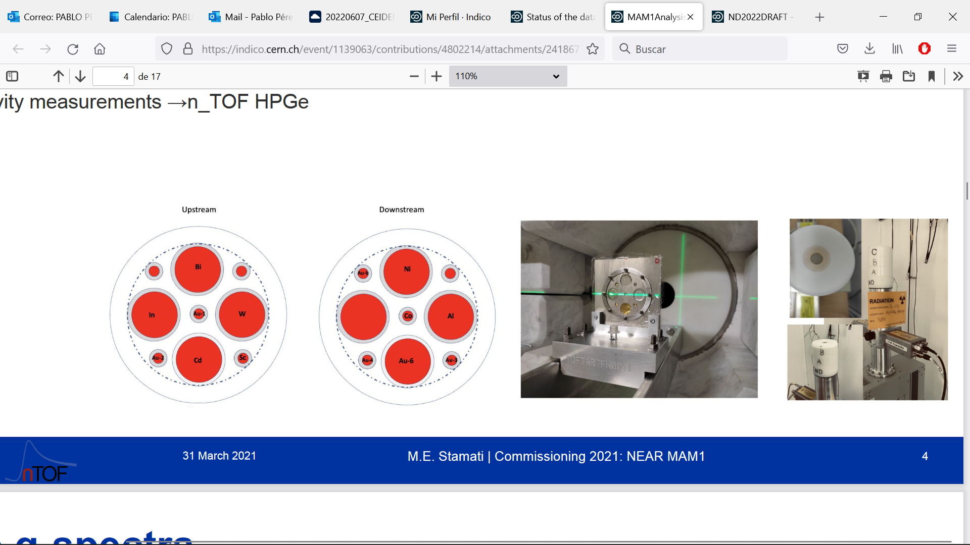
Backup. Commissioning with MAM1
M.E. Stamati, A. Manna, R. Mucciola, A. Mengoni, N. Patronis, C. Massimi, G. Gervino
Pablo Pérez Maroto || CEIDEN-GUN Meeting || 09/06/2022

Slide 26
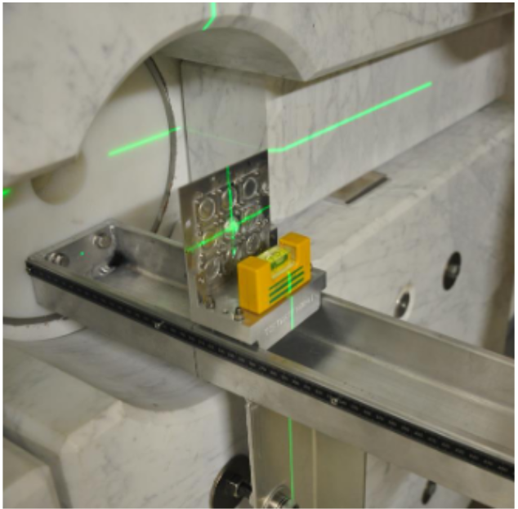
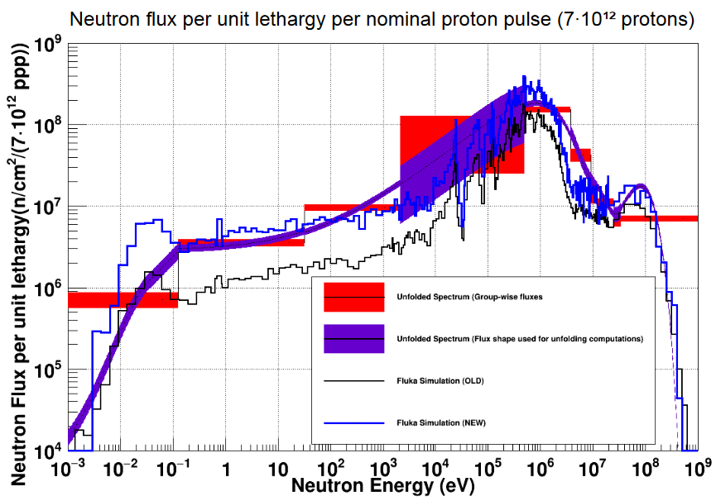
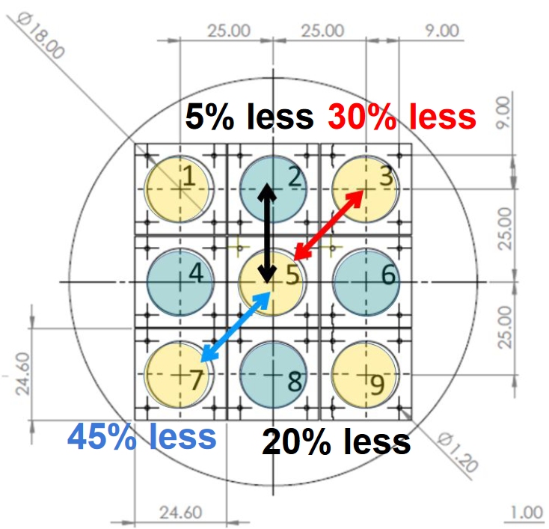
Backup. Commissioning with MAM2
P. Torres & J. Praena
Pablo Pérez Maroto || CEIDEN-GUN Meeting || 09/06/2022

