Slide 1
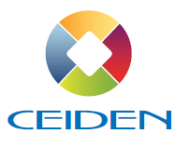
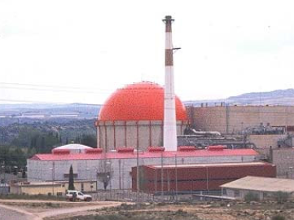
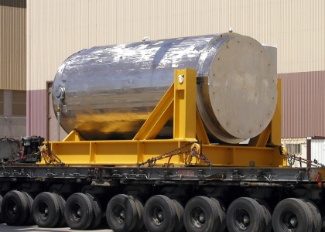
CEIDEN: R&D SPANISH NUCLEAR PLATFORM

Slide 2
¿What is CEIDEN?
¿What is?
CEIDEN is a Spanish Organization for the coordination of the efforts and needs of Nuclear Fission Technology R&D.
¿What does?
Definition and development of joint projects, and the presentation of a common position for national and international commitments and proposals in the Nuclear Fission R&D field.
¿Who?
CEIDEN includes all sectors related to R&D Nuclear Fission in Spain.

Slide 3
CEIDEN ORGANIZATION
Consejo Gestor CEIDEN: Executive Committee
President: Rosario Velasco (CSN)
Secretary: Pablo T. León (ENDESA)
SECTOR | ENTIDAD | SUPLENTE
Utilities(3 rep): | ENDESA
 | IBERDROLA
 | GNF
Fuel Cycle(2 rep): | ENUSA
 | ENRESA
R&D Institutions(2 rep): | TECNALIA | GDES
 | CIEMAT
Universities (1 rep): | UPM | UPC
Eng & Const. Companies (1 rep): | GNF ENG | IBERD.ING.
Equipment Companies(1 rep): | ENSA
Services Companies(1 rep): | TECNATOM | ENWESA
REGULATOR(2 rep): | CSN
ADMINISTRATION (1 rep): | MINETUR
ADMINISTRATION (1 rep): | MINECO
General Assembly
Nº Ceiden Members: 93
Nº Contributors: 10

Slide 4
VISION of CEIDEN Technology Platform
Develop R&D activities focused on the safe, reliable and competitive operation of actual nuclear installations and the fuel cycle, and the development of new nuclear projects
Objectives
Boosting growth of scientific and technological basis of nuclear fission
Promote and coordinate nuclear R&D initiatives between Companies, Government Agencies, Research Centers and Universities
Suggest the National Plan of R&D priority technology lines in the Nuclear Fission Sector.
Advise and coordinate the participation in international projects
Promote the Spanish nuclear technology in appropriate forums.

Slide 5
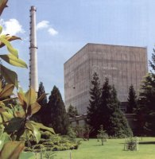
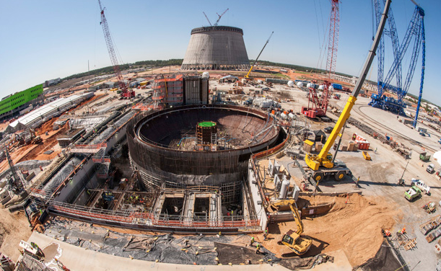
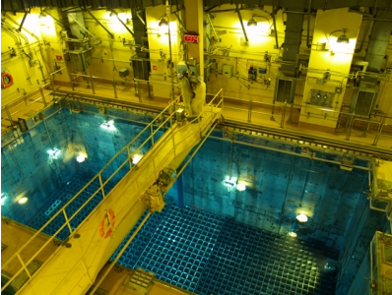
STRATEGIC AGENDA
1.- LTO
Nuclear Sector Challenges
3.- New Projects & Technologies
2.- Waste Management

Slide 6
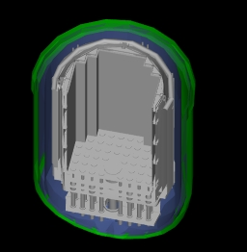

MATERIALS DEGRADATION
Materials Studies from Jose Cabrera (Zorita) NPP, currently beign dismantled
ZIRP Project
Objetive: Cut and remove part of the Internal Reactor Vessel, for laboratory testing, and evaluating the extracted materials degradation and aging properties
Participants: CSN, ENRESA, Gas Natural, UNESA/CCNN, CIEMAT, GNF Engineering, ENSA and TECNATOM
2nd Phase: Lead by EPRI, with Westinghouse, Studsvik, US NRC participation
Concrete Project
Objective: Cut and remove some of the concrete structures of the plant, to experimentally study the variation of the characteristics of these materials
Participants: CSN, ENDESA, ENRESA, GNF-GNF Engineering, IBERDROLA, and IETcc (CSIC)

Slide 7

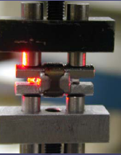
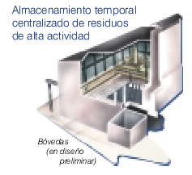
NUCLEAR FUEL
Storage and Transport of Spent Fuel Program
Objective: Forum to promote and coordinate research projects on used nuclear fuel, to improve its management
Participants: CSN, ENRESA, ENUSA, UNESA/CCNN, CIEMAT, GNF Engineering, ENSA, TECNATOM, ETSICM
EPRI, W, DOE, ORNL; IRSN and EDF; Vattenfall and NEA/OECD
Projects:
Fuel Rod Creep with PWR high burnup ZIRLO: Completed
Fuel Rod Creep of Zircaloy BWR pod 2: Completed
Isotopy of fuel with high burnup PWR: Completed
Isotopy of BWR fuel: Completed
Fracture criteria fuel rod material: Completed
Break through low-speed impacts: Completed
Spanish participation in the "Extended Storage Collaboration Program (ESCP)" promoted by the American nuclear industry
New Project: "Integrity fuel rod hydridation in irradiated severe conditions of storage and transport"

Slide 8
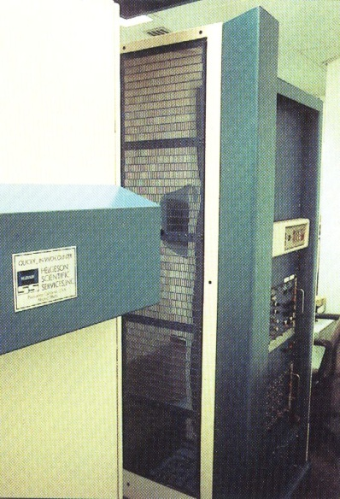
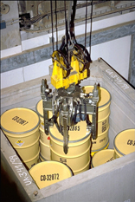
RADIATION PROTECTION AND DOSIMETRY
Development of in vitro dosimetry
Objective: Increase national capacity assessment of internal doses from alpha emitters through biological samples
Participants: CIEMAT, UNESA, ENUSA, ENRESA, CSN, Tecnatom, Geocisa, Medidas Ambientales, Iberdrola Ingeniería y GNF Engineering
Laboratory for calibration of neutron patterns
Objective: Help specify the intended applications for existing and future laboratories and promote possible industrial applications and research
Participants: CIEMAT, ETSIIM, UAB, CC.NN/UNESA, SEPR, CSN, ENRESA and ENUSA

Slide 9
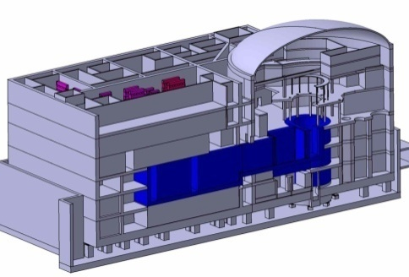
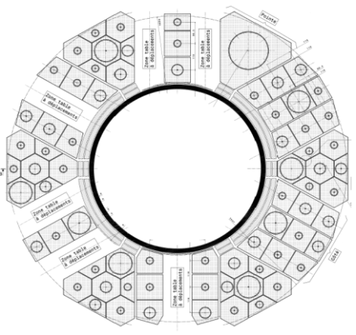
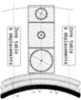

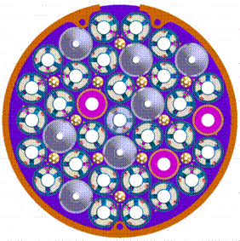
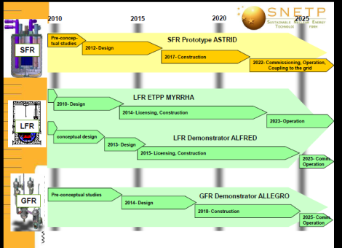
NEW NUCLEAR PROJECTS
JULES HOROWITZ REACTOR PROJECT
Objective: Participate in the design, construction and operation of experimental fission reactor Jules Horowitz (JHR)
Participants: Spanish consortium: CIEMAT, CSN, EnuSA, TECNATOM, Employers Grouped, ENSA and GNF Engineering
Spanish contribution: € 8.6 M, gives the consortium a 2% of the rights of use of the facility for future R&D projects that require irradiation of samples
ESNII PROGRAM
Objective: Participation in the European Sustainable Nuclear Industrial Initiative program (ESNII)
Participants: CIEMAT, Iberdrola, Tecnatom, Empresarios Agrupados, ENSA, GNF Engineering, UPM and UPV

Slide 10
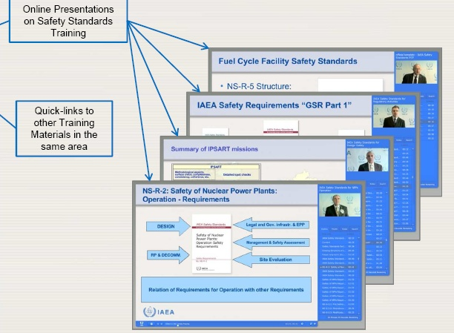
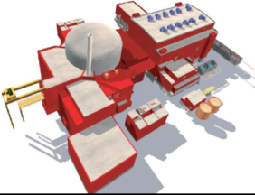
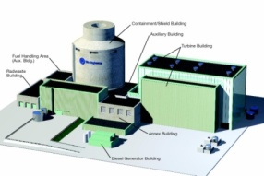
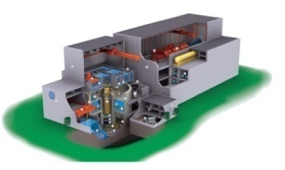
CROSS-CUTTING TOPICS (1/2)
EDUCATION/TRAINING GROUP: FORMACION +
Objective: Promote coordination of education and training nationally, and Spanish participation in international programs and networks (EU EUROSAFE, IAEA, Latin America)
Participants: CIEMAT, TECNATOM, CSN, UPM, UAB, UPV/EHU, UPV, UPC, Titania, ENUSA, Foro Nuclear, Thunder, INDRA and ENDESA
CAPABILITIES PROJECT
Objectives:
Phase 1: Analyze the current capabilities of the Spanish industry to face a new nuclear project
Phase 2: Promote that the Spanish suppliers have the necessary skills to participate in new nuclear projects
Participants: Endesa, Iberdrola, GNF, Foro Nuclear
W, GE, AREVA

Slide 11



CROSS-CUTTING TOPICS (2/2)
HORIZON 2020
Monitoring European Euratom programs within the Horizon 2020 program, in order to inform CEIDEN members of opportunities for R&D in Europe, and promote a coordinated Spanish participation
SNE-TP
Monitoring of activities of the European Technology Platform for Sustainable Nuclear Energy, which define the strategic lines of support for R&D in Europe Nuclear Fission
NATIONAL R&D BUDGET
Analysis of the annual budget for Nuclear R&D in Spain
45 M€

Slide 12
Conclusions
The CEIDEN technology platform is an entity coordinating the needs and efforts of R&D in the field of nuclear fission technology, nationwide
Nearly 100 public and private entities participate in CEIDEN, which represents the majority of the players in this field in Spain
CEIDEN develops 8 lines of specific work, with 25 entities involved. The majority of CEIDEN programs have relationships with equivalent international programs, being highly valued in this environment
CEIDEN has established cooperative ties with Latin American institutions with similar objectives, especially in the field of education & training
CEIDEN objective is to transmit to the Administration and to the Spanish companies the idea that the promotion of R&D supports nuclear Spanish industrial exports, and the safe operation of short, medium and long term of our nuclear power plants

Slide 13
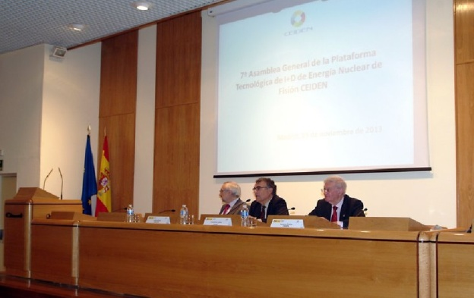
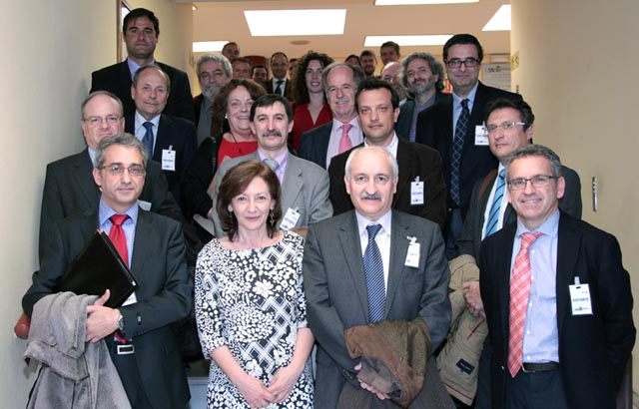
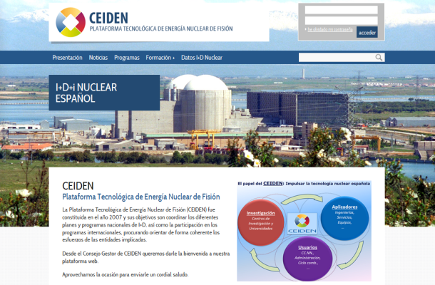
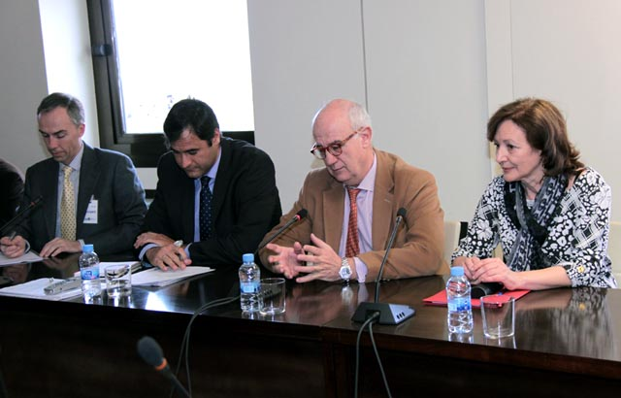
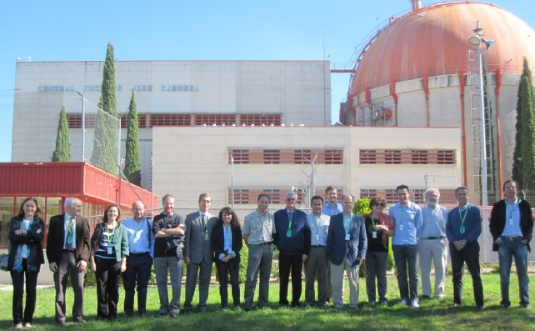
Thanks for your Attention

